Slide 1
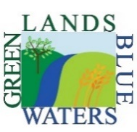
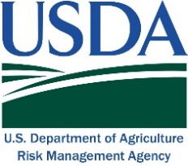
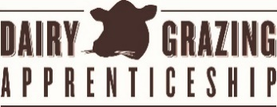
Managed Grazing for Dairy Profits
Seasonal Pasture Utilization on Seven Grazing Dairy Farms in the Midwest
Month-to-month percentage of dry matter intake from pasture for three classes of dairy cattle
Days of pasture grazing per month
http://greenlandsbluewaters.net/Perennial_Forage/dairy.html

Slide 2
Durovec Dairy Bob and Patty Durovec Meadowlands, MN
Managed Grazing for Dairy Profits. 2018. Midwest Perennial Forage Working Group, Green Lands Blue Waters. www.greenlandsbluewaters.net/dairy.html. Study conducted with funding from USDA-Risk Management Agency.

Slide 3
Haverinen Dairy Wayne and Heidi Haverinen Menagha, MN
Managed Grazing for Dairy Profits. 2018. Midwest Perennial Forage Working Group, Green Lands Blue Waters. www.greenlandsbluewaters.net/dairy.html. Study conducted with funding from USDA-Risk Management Agency.

Slide 4
Springside Dairy, LLC Olaf Haugen, Vance and Bonnie Haugen Canton, MN
Managed Grazing for Dairy Profits. 2018. Midwest Perennial Forage Working Group, Green Lands Blue Waters. www.greenlandsbluewaters.net/dairy.html. Study conducted with funding from USDA-Risk Management Agency.

Slide 5
Law-Rae Manor Dairy
Farmer name: David & Susan Suprenant
Location: Manteno, IL
Managed Grazing for Dairy Profits. 2018. Midwest Perennial Forage Working Group, Green Lands Blue Waters. www.greenlandsbluewaters.net/dairy.html. Study conducted with funding from USDA-Risk Management Agency.

Slide 6
Paris Family Dairy Bert and Trish Paris
Belleville, Wisconsin
Managed Grazing for Dairy Profits. 2018. Midwest Perennial Forage Working Group, Green Lands Blue Waters. www.greenlandsbluewaters.net/dairy.html. Study conducted with funding from USDA-Risk Management Agency.

Slide 7
Tomandl Farms Farmer name: Joe and Christy Tomandl
Location: Medford, WI
Managed Grazing for Dairy Profits. 2018. Midwest Perennial Forage Working Group, Green Lands Blue Waters. www.greenlandsbluewaters.net/dairy.html. Study conducted with funding from USDA-Risk Management Agency.

Slide 8
Wedemeier Dairy Scott and Catherine Wedemeier Maynard, IA
Managed Grazing for Dairy Profits. 2018. Midwest Perennial Forage Working Group, Green Lands Blue Waters. www.greenlandsbluewaters.net/dairy.html. Study conducted with funding from USDA-Risk Management Agency.

Slide 9
Seasonal Pasture Utilization by Three Classes of Dairy Cattle on Seven Midwestern Dairies
Dry cows Lactating cows Replacement heifers
Managed Grazing for Dairy Profits. 2018. Midwest Perennial Forage Working Group, Green Lands Blue Waters. www.greenlandsbluewaters.net/dairy.html. Study conducted with funding from USDA-Risk Management Agency.

