Slide 1
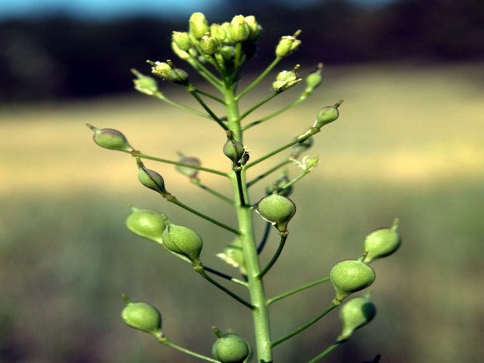





Oilseed "cash cover crops" for ecosystem services and economic return
M. Scott Wells
University of Minnesota
Department of Agronomy and Plant Genetics

Slide 2
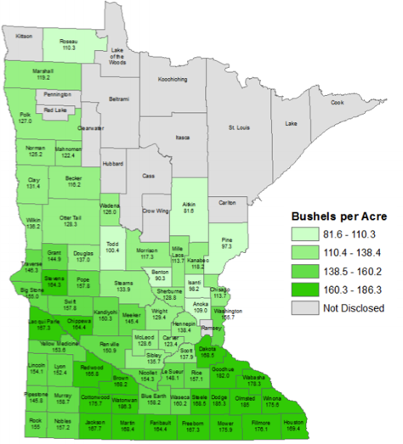
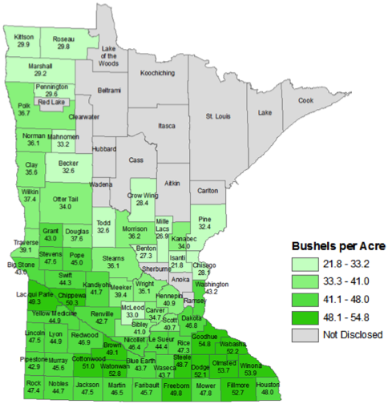

2016 Corn
8.0 million ac
2016 Soybean
7.5 million ac

Slide 3
2015 Corn
8.1 million ac
2015 Soybean
7.6 million ac
What are some of the consequences resulting from the loss of landscape diversity and continuous living soil covers?

Slide 4
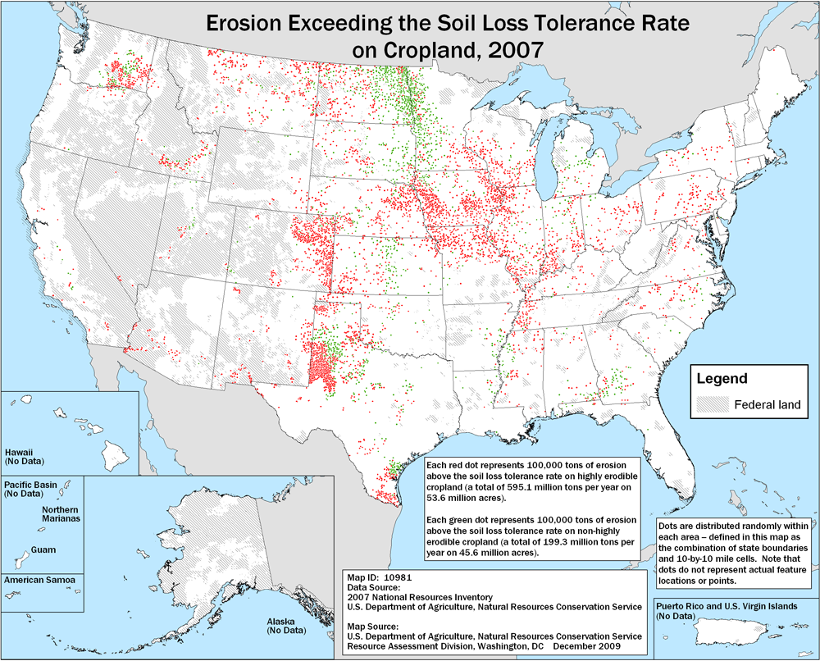
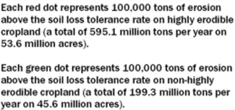
Erosion Exceeding Tolerance
NON-HIGHLY ERODABLE LANDS
USDA-NRCS, 2007
Notes:
Red= exceeds NRCS tolerance rate on highly erodible land.
Green exceeds NRCS tolerance rate on non-highly erodible land
MINNESOTA EXCEEDS TOLERANCE RATE ON NON-HIGHLY ERODABLE LAND

Slide 5
Statewide nitrogen sources to surface waters
https://www.pca.state.mn.us/news/report-nitrogen-surface-water

Slide 6
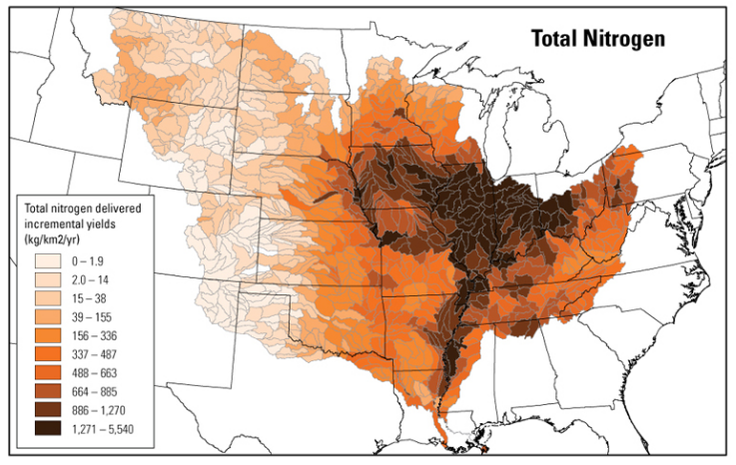
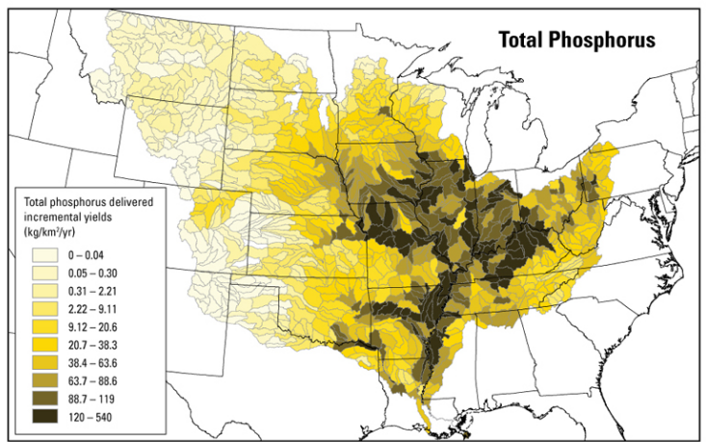
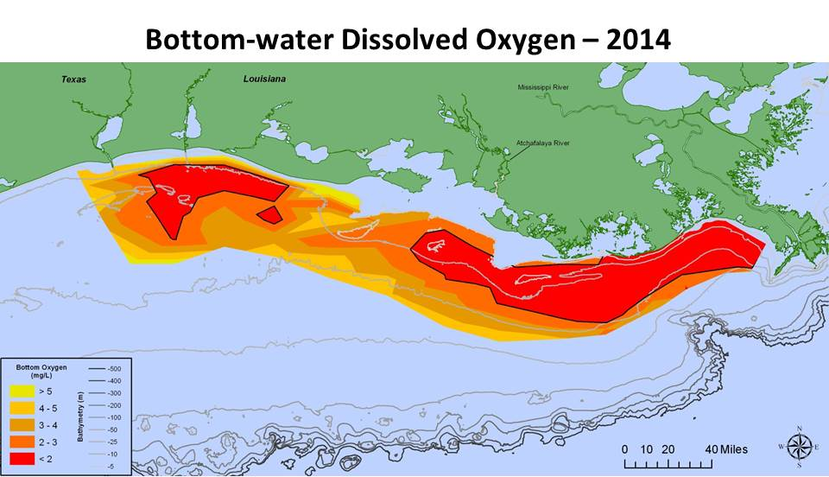
Downstream Impacts (Hypoxic Zone)
Ravalais and Turner, 2014.
Robertson and Saad, 2011.

Slide 7
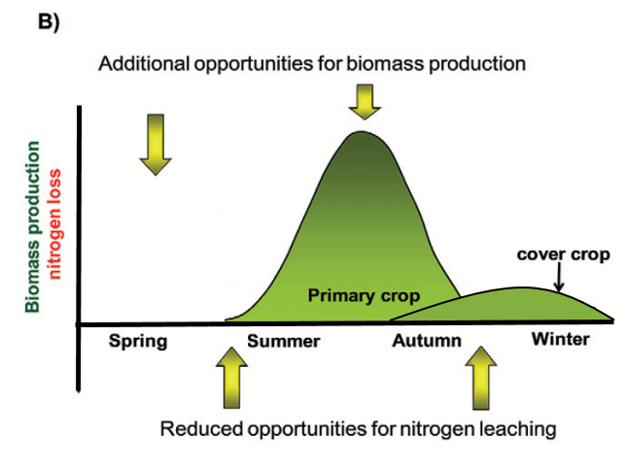
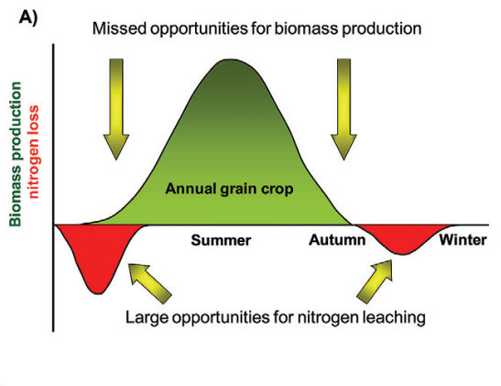
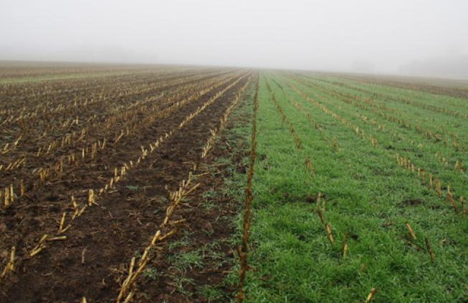
Plants Can Fill the Void

Slide 8
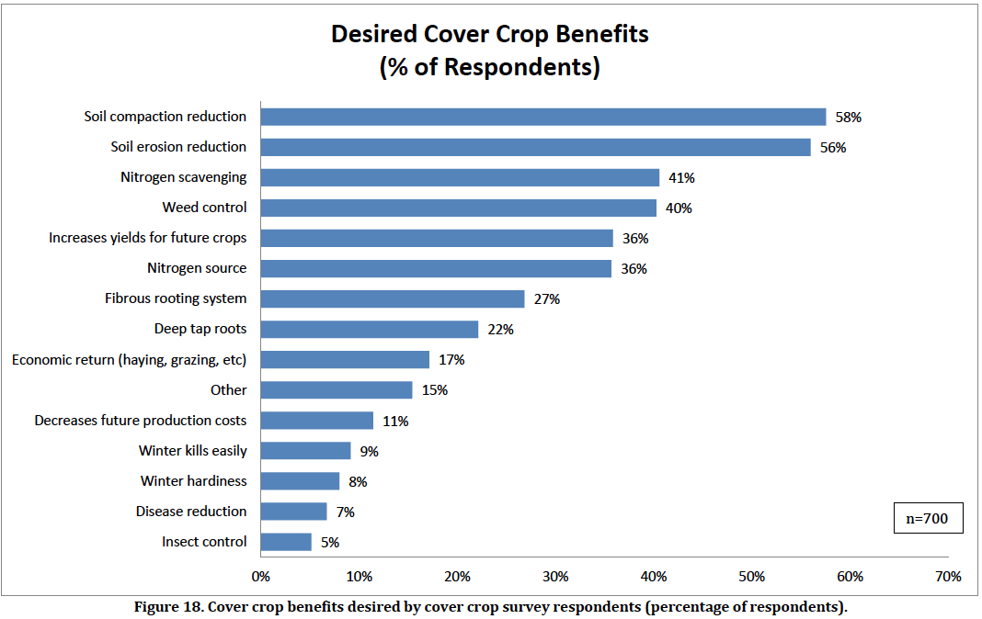
2013-2014 SARE/CTIC Cover Crop Survey

Slide 9
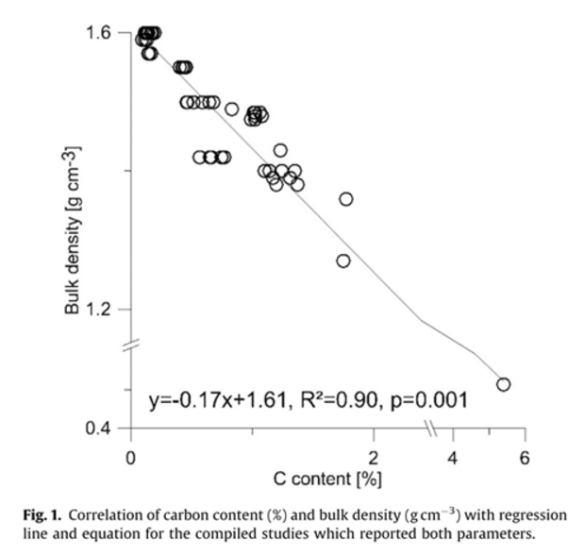
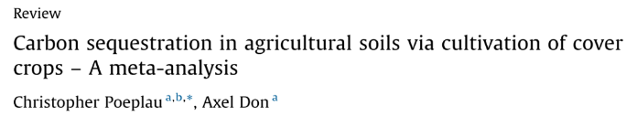
Reduce Soil Compaction

Slide 10
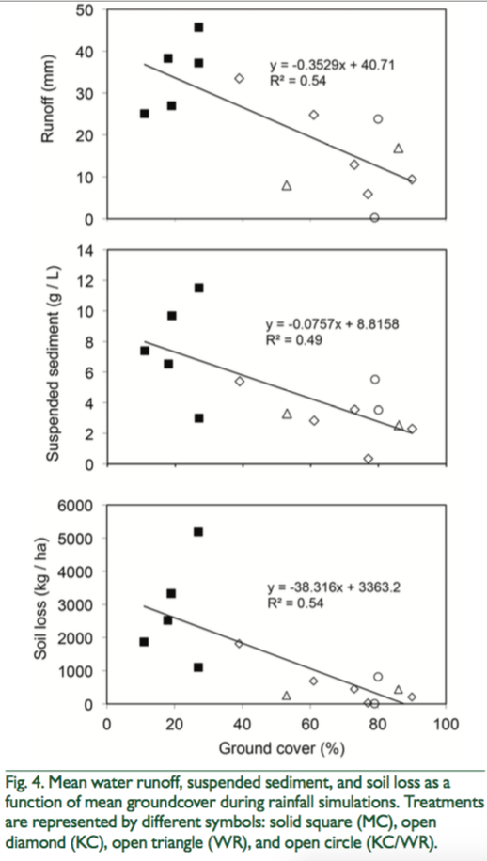
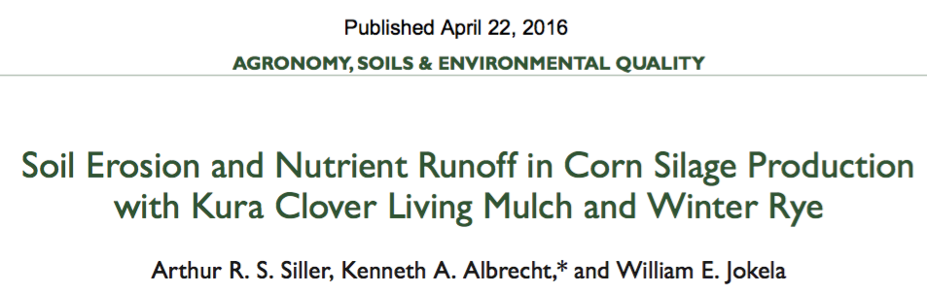
Soil Erosion
Kura clover living mulch has potential to reduce water runoff by 50%, soil loss by 77%, and P and N losses by 80% relative to monocrop corn on sloping landscapes. Winter rye sown after silage harvest provided similar soil and nutrient conservation benefits, but without the potential benefit of contributing biologically fixed N to the system as does Kura clover.

Slide 11
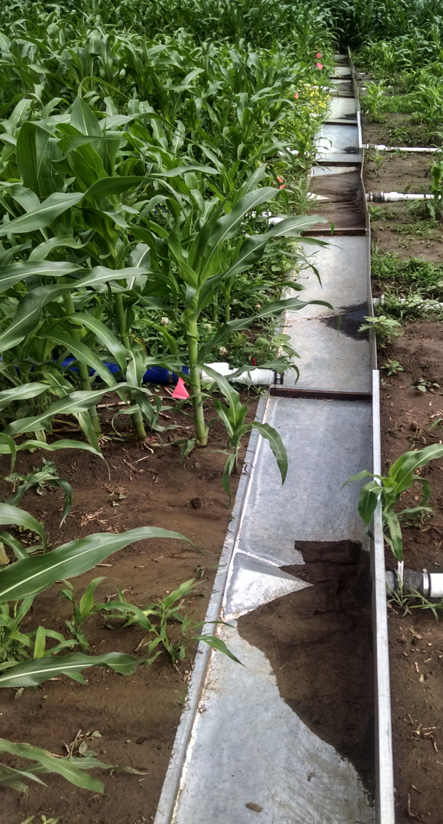
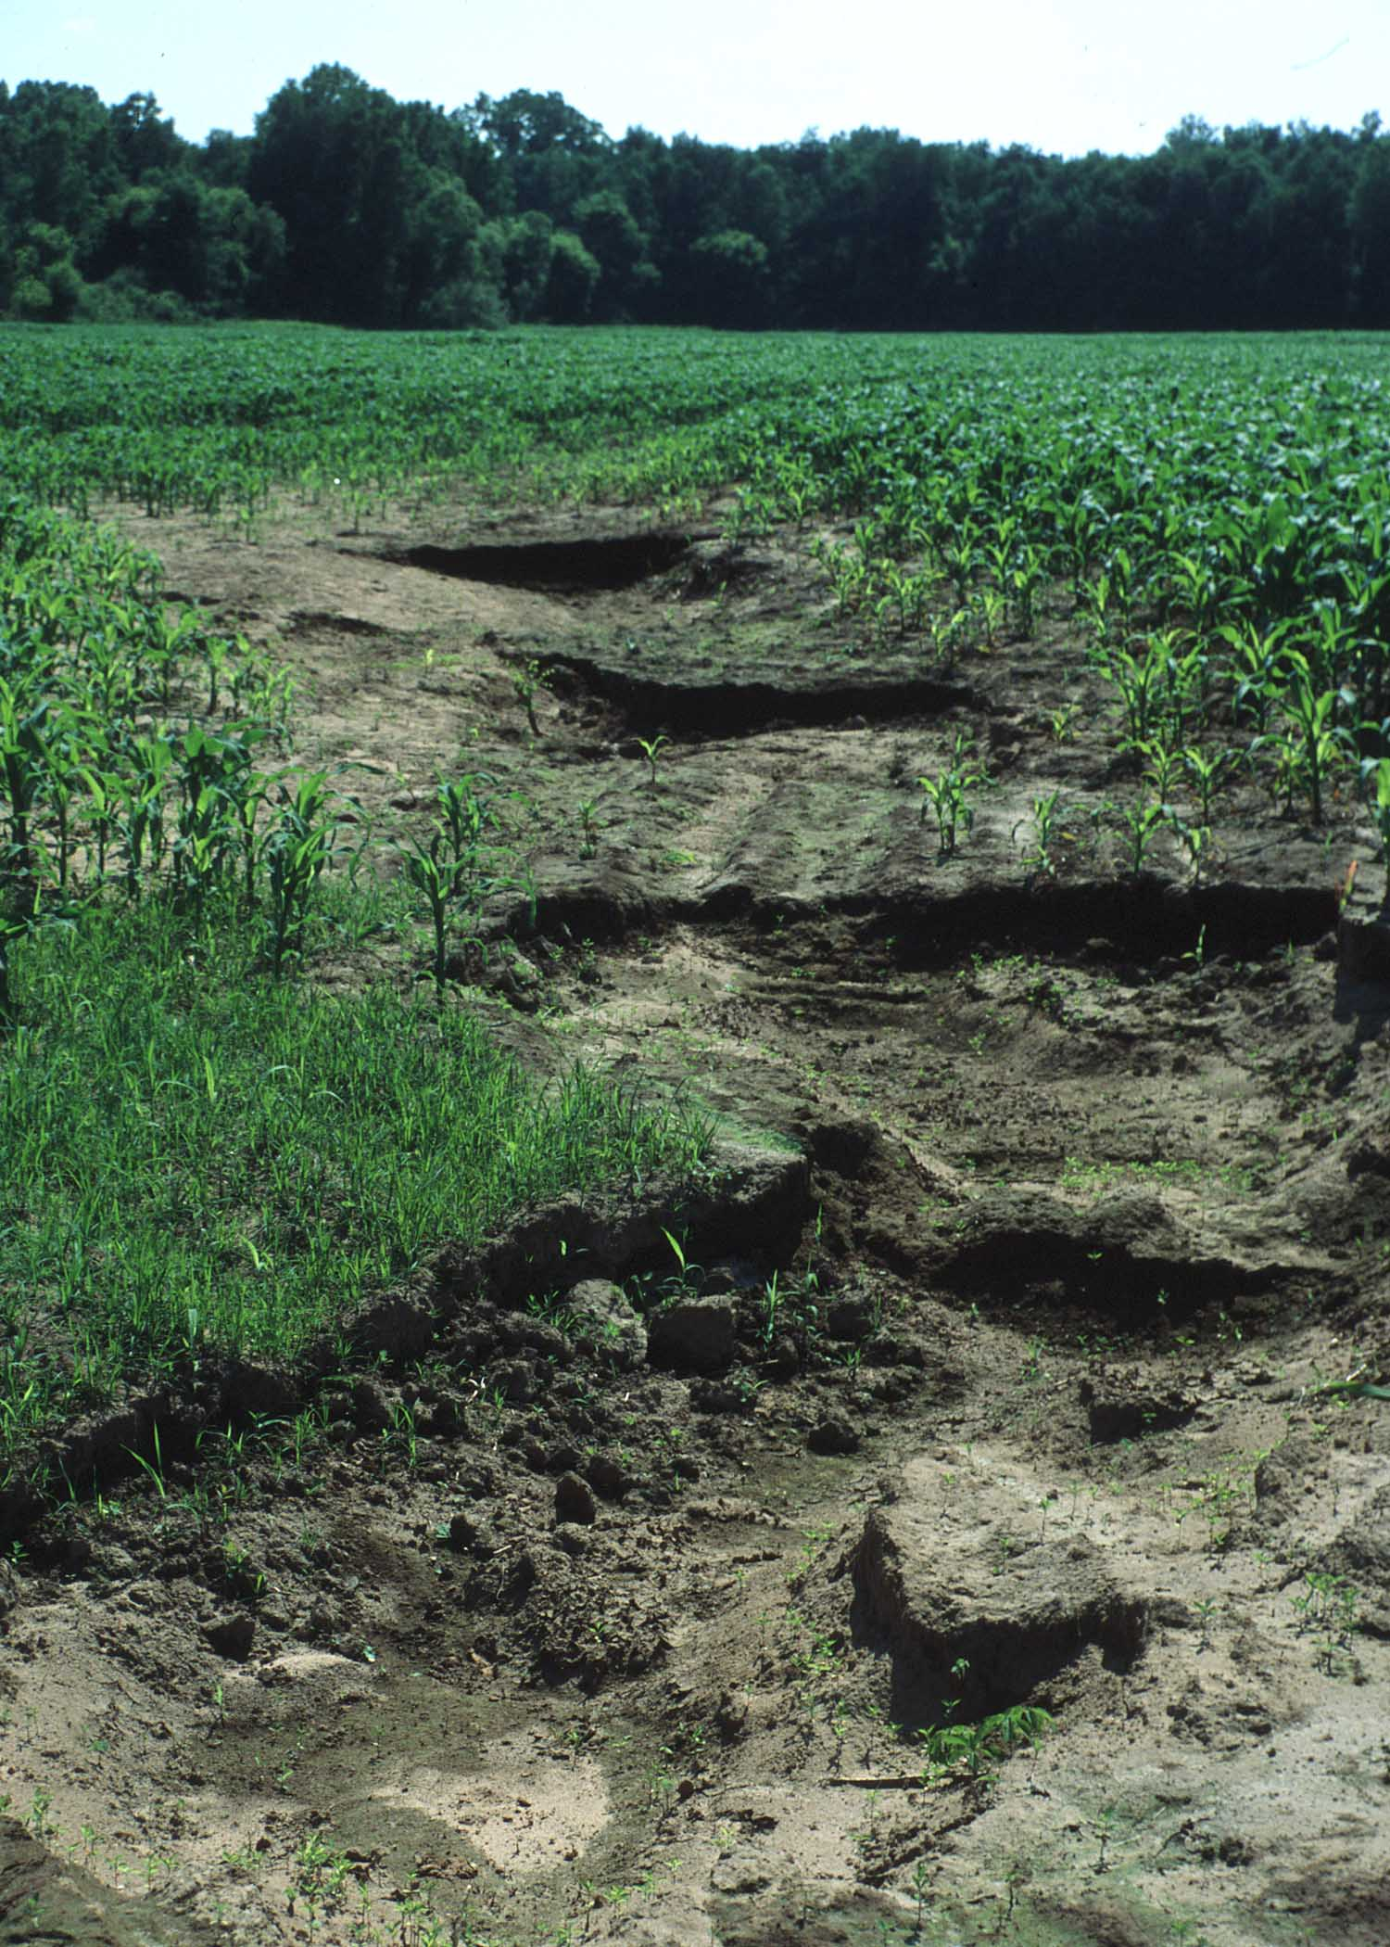
Soil Erosion
Conventional
Soil loss, conventional : 7.98 +- 3.55 tons acre⁻¹
Soil loss, living mulch : 0.58 +- 0.40 tons acre⁻¹
Living mulch
(Baker, 2016. Unpublished)
Conventional
Soil loss from corn fields with and without living at Rosemount, MN. (Baker, 2016. Unpublished)

Slide 12
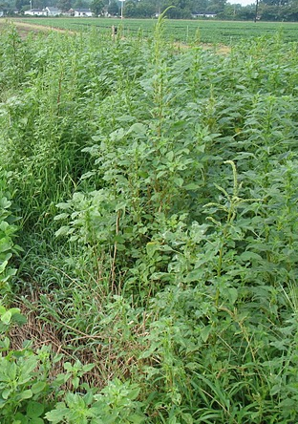
Control Weeds
Redroot Pigweed (Amaranthus retroflexus)
Adapted from Smith et al., 2011

Slide 13
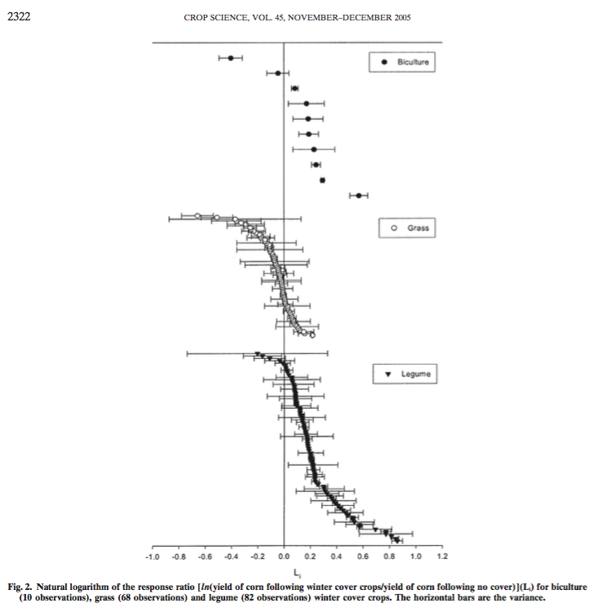


Increase Yields of Following Crop

Slide 14
Increase Yields of Following Crop
Decreased corn yield following a grass-type cover crop
Increased corn yield following a grass-type cover crop

Slide 15
Increase Yields of Following Crop
Increased corn yield following a legume-type cover crop

Slide 16
2013-2014 SARE/CTIC Cover Crop Survey

Slide 17

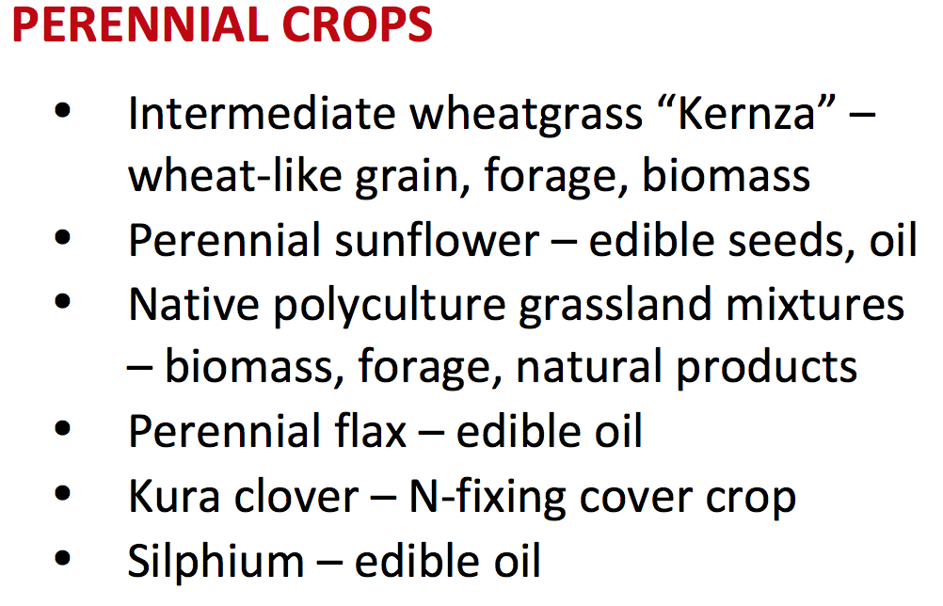
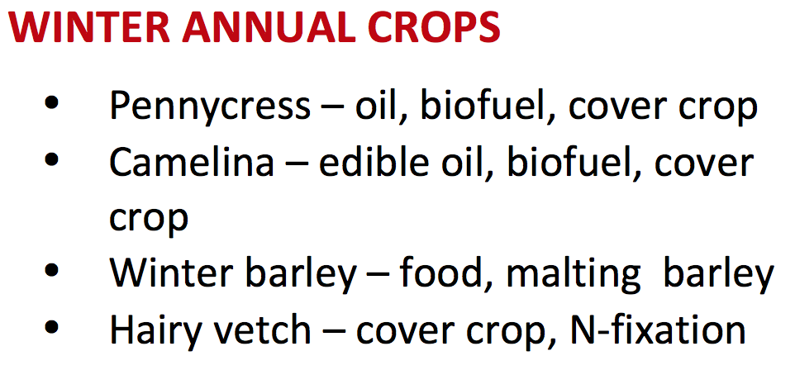
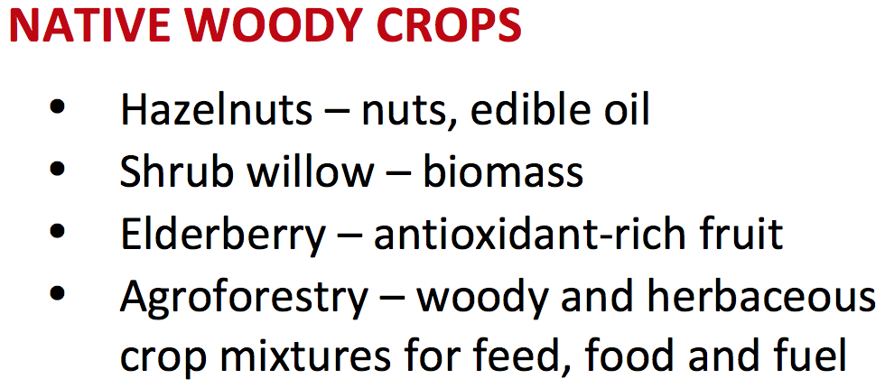
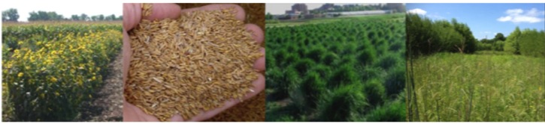







Developing New Perennial and Winter Annual Crops to Enhance Minnesota’s Soil and Water Resources
Pg. 26
EQB Report

Slide 18
New Cash Cover Crops: Winter Camelina and Pennycress
Brassicaceae (mustard family)
Cold-tolerant winter annual
Rapid seed maturity
Economic opportunity
  Pennycress
    Bio-based products
    Biodiesel
  Camelina
    Food grade oil
    Biodiesel
    Protein and fiber
Pennycress
Camelina

Slide 19




Developing Markets: New Economic Opportunities
Agricultural Utilization Research Institute (AURI).
  Extracting oil, fiber, and proteins that can be used for industrial testing Industry Partners
General Mills
  Camelina-oil, fiber and protein
PepsiCo
  Pennycress- oil for polymers
JetBlue
  Pennycress-jet fuel

Slide 20
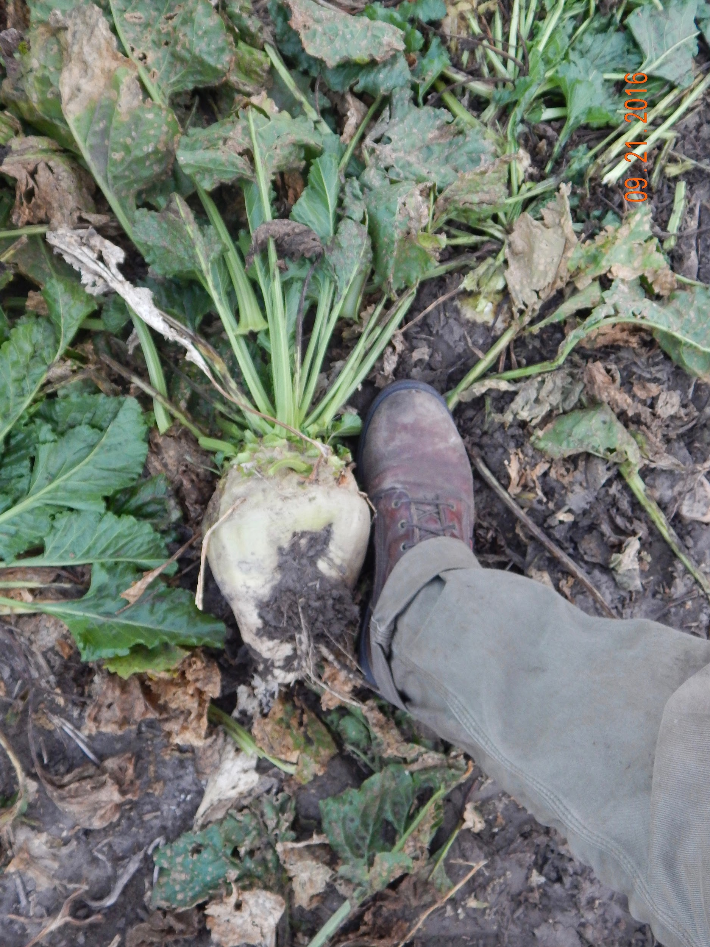
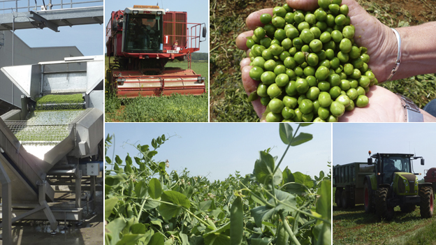
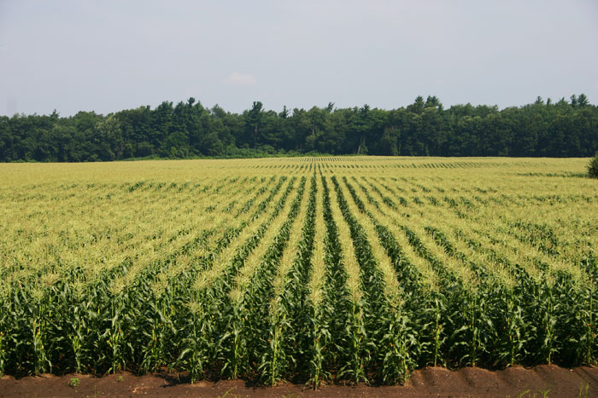
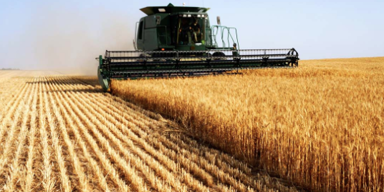
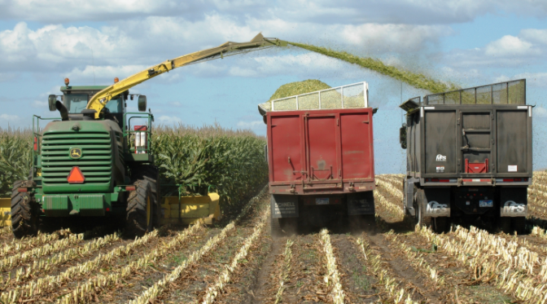
Opportunities: Early Harvested Crops
48,500 ac
103,200 ac
435,000 ac
1.2 million ac
Over 2 million acres in MN!
500,000 ac

Slide 21
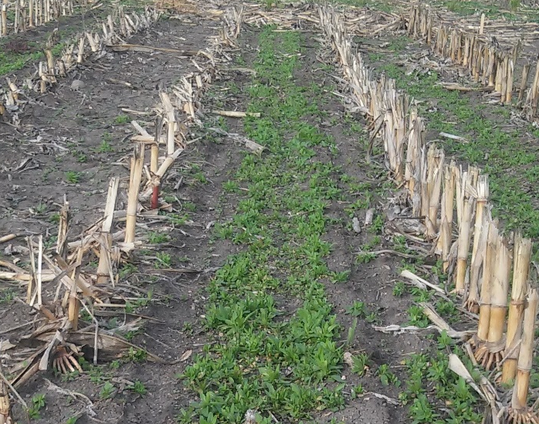
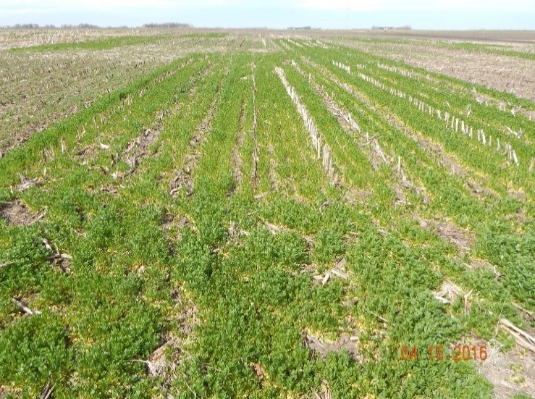
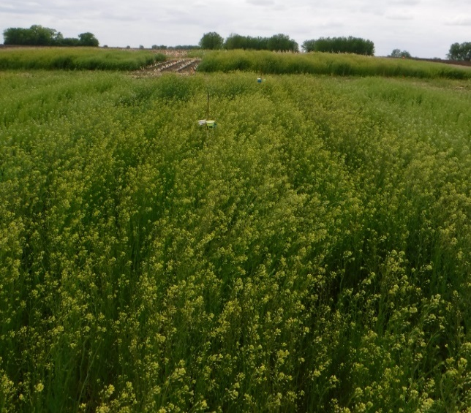
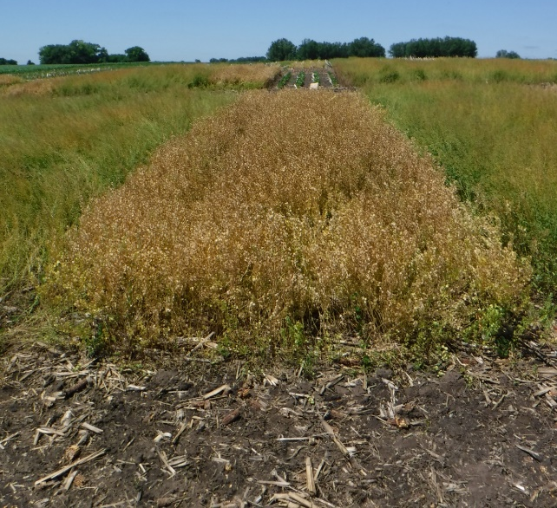
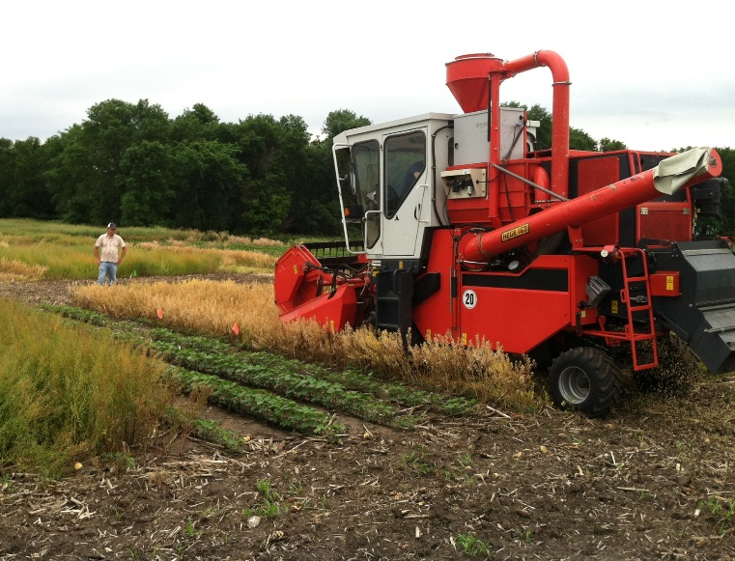
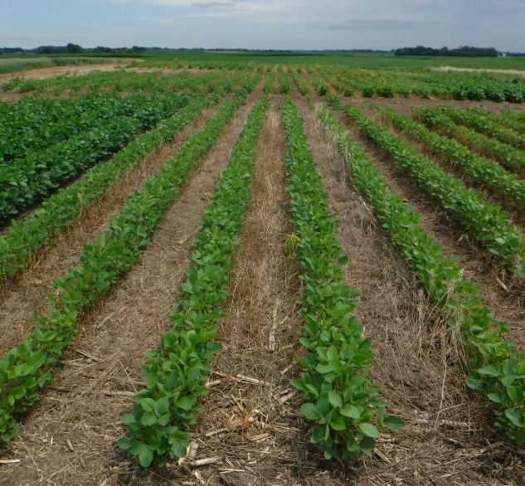
Relay Cropping System
Small Grains and Silage Corn
No-till Plant Soybean
November 15th
April 18th
May 31st
June 16th
June 17th
July 6th

Slide 22
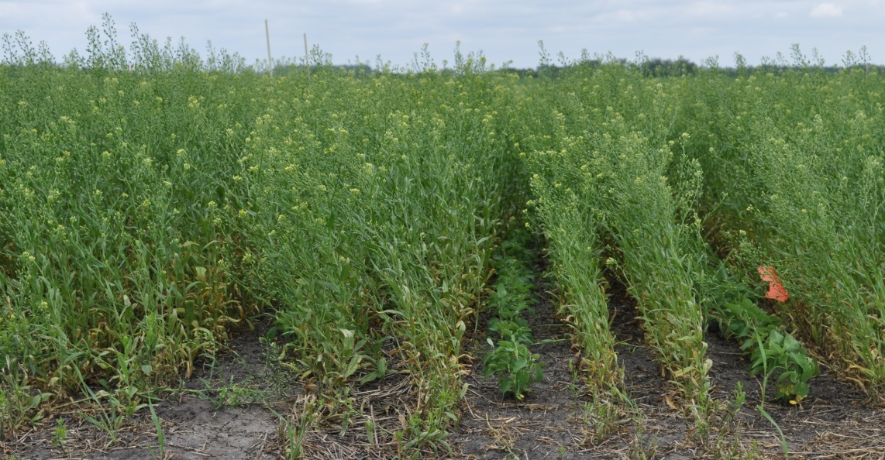
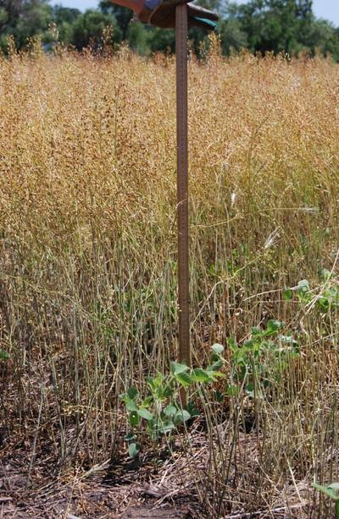
Relay Cropping System
Small Grains and Silage Corn
No-till Plant Soybean
Early June
Soybean
November 15th
April 18th
May 31st
Photo: Russ Gesch. USDA-ARS
Soybean
June 16th
June 17th
July 6th
Photo: Russ Gesch. USDA-ARS

Slide 23
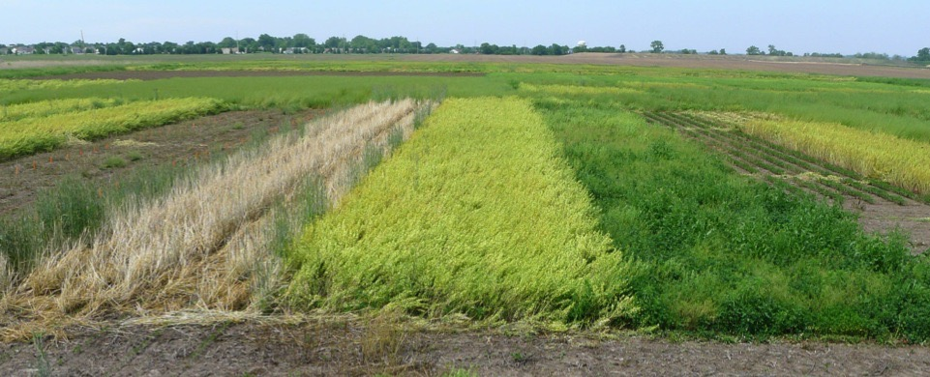

Relay Cropping: Weed Control
Winter Rye
Field Pennycress
No Cover Crop Weedy Check
WEEDY!

Slide 24
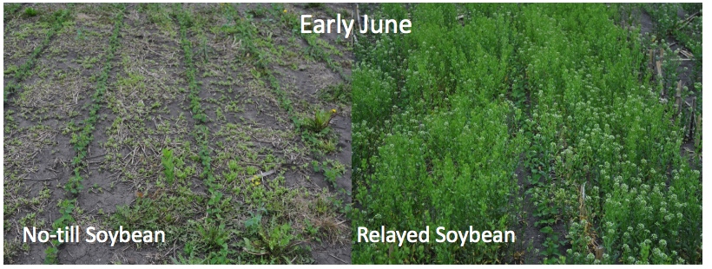
Relay Cropping: Weed Control
*
*
*
LSD: P < 0.05
Adapted from Johnson et al., 2015. Agron J. 108:532-540

Slide 25
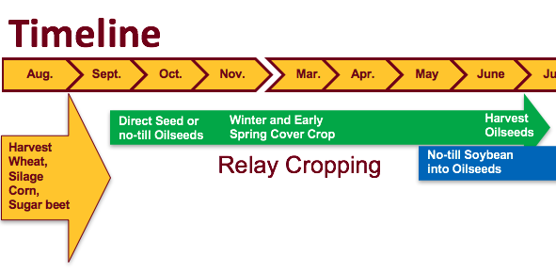
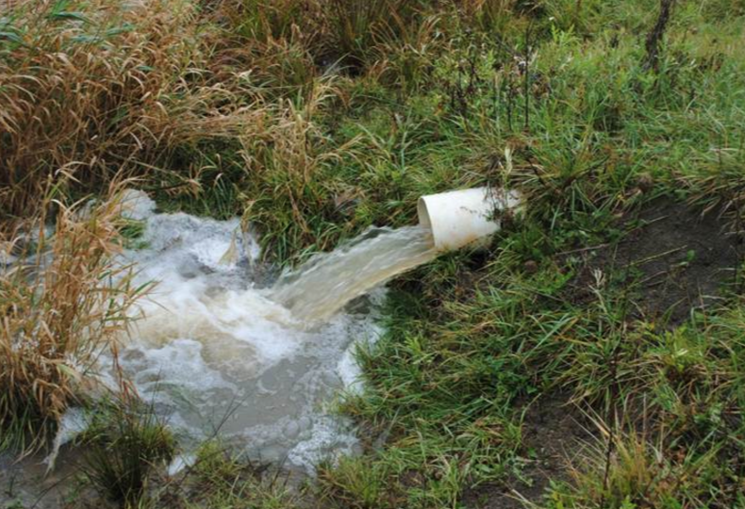
Annual Tile Drainage Loss in Corn-Soybean Rotation
Waseca, 1987-2001
Gyles Randall, 2003

Slide 26
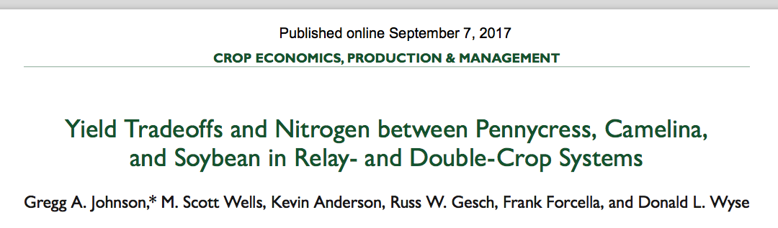
Relay Cropping Extractable Soil N Reduction

Slide 27
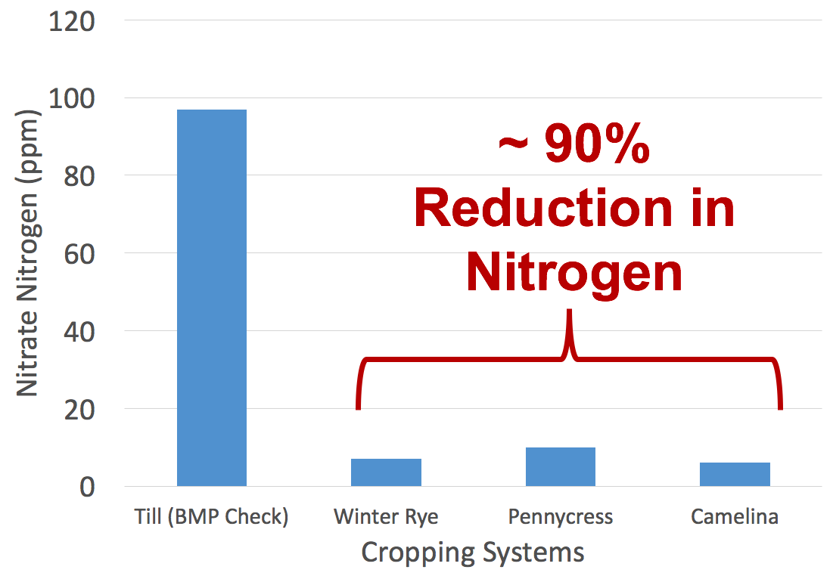
Relay Cropping Spring Soil N Reduction
Spring Nitrate Retention
Ott et al., 2018. Unpublished
27

Slide 28
Relay Cropping Oilseed Economics
Notes: significant treatment effect (P <0.05); value used for oilseed = $18/CWT (canola); value used for soybean = $9.23/bushel
LSD: P < 0.05
Hoerning, 2018. Unpublished.

Slide 29
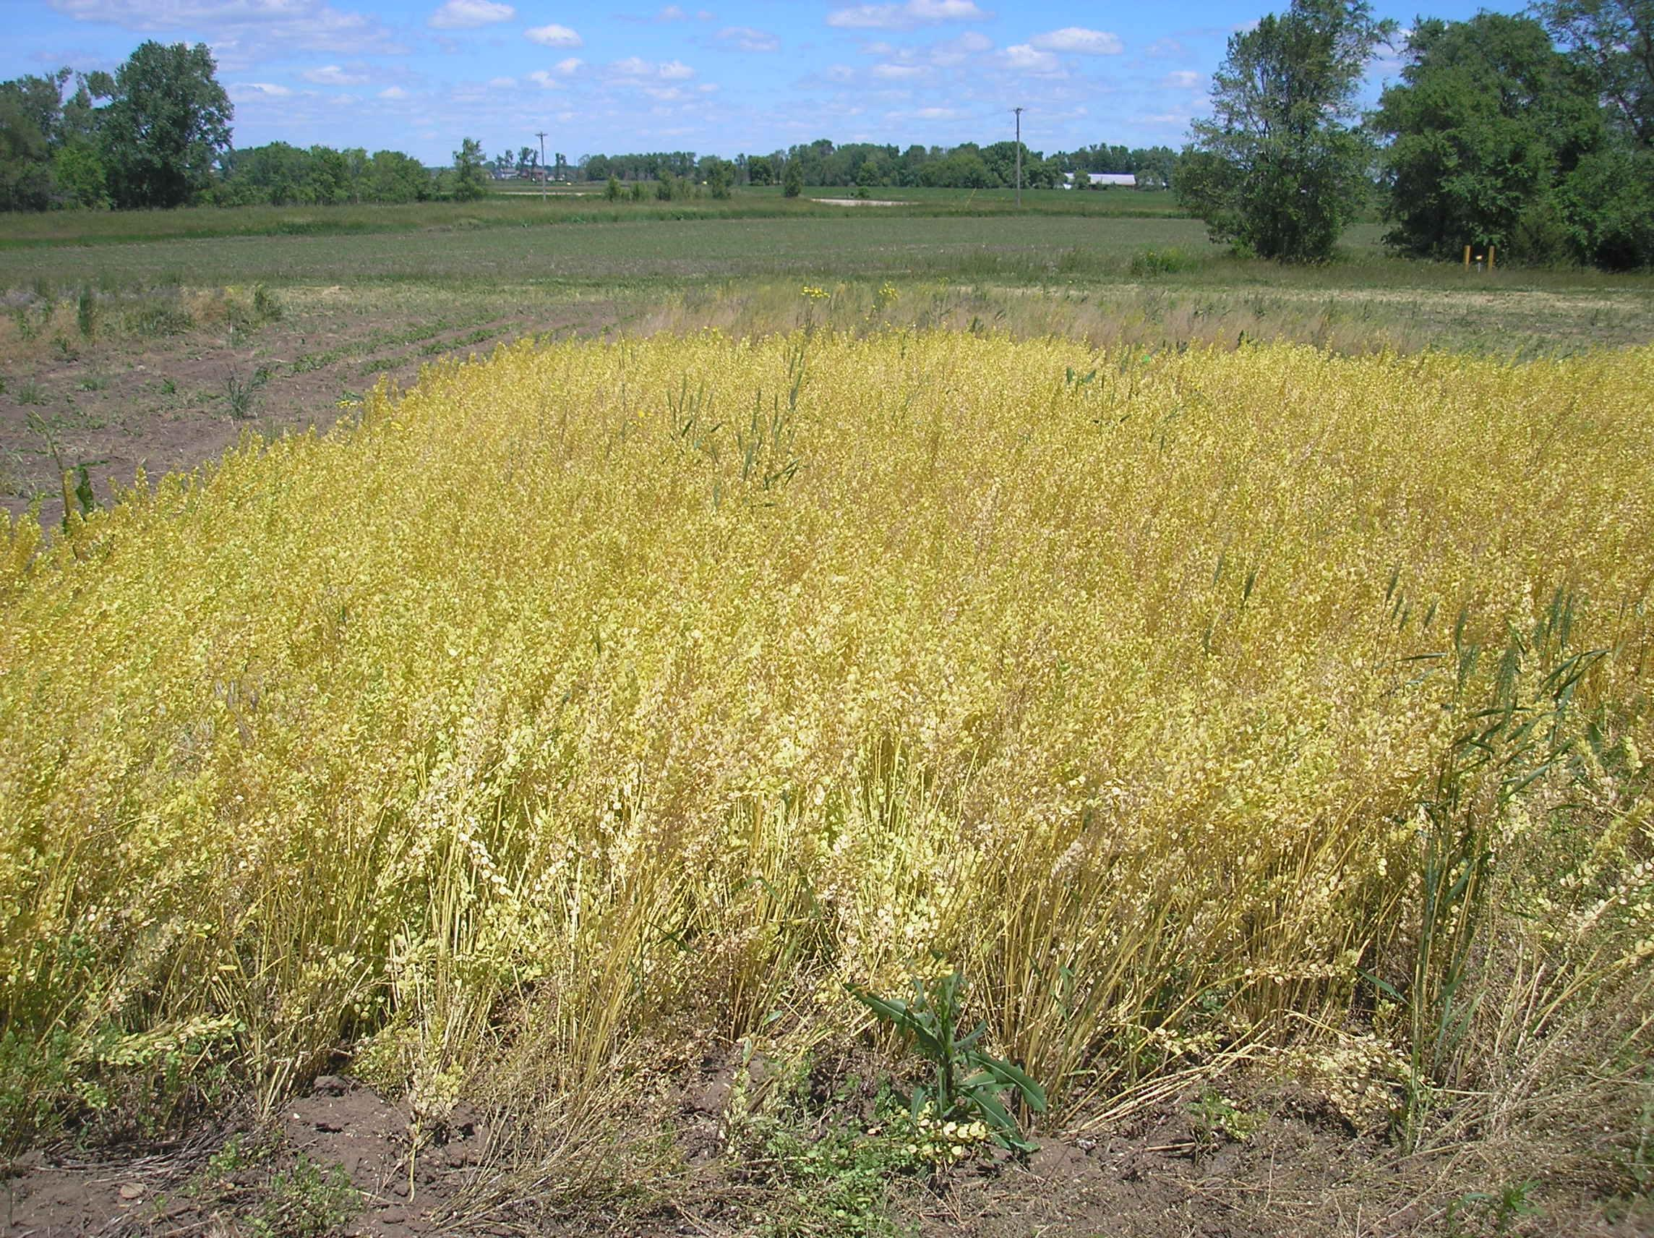
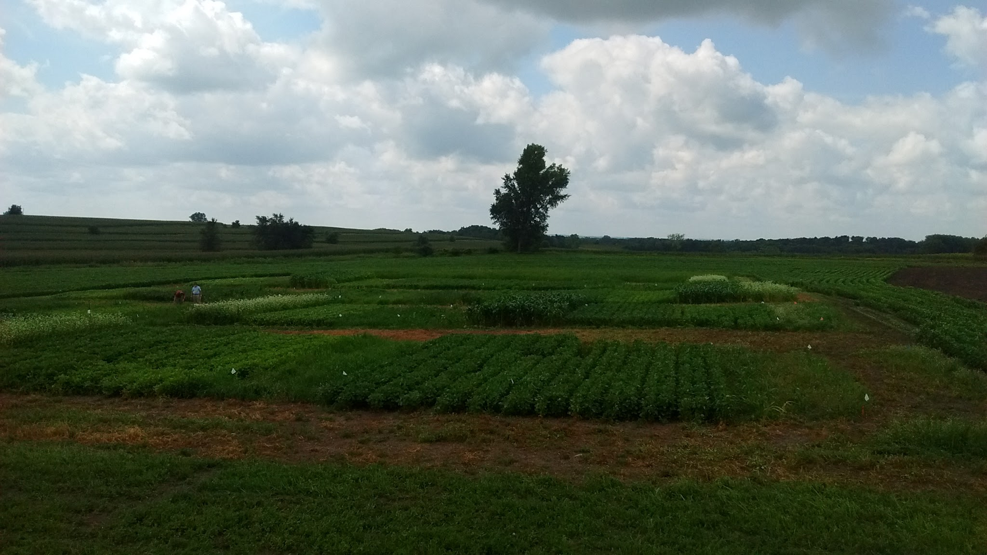
Double Cropping Opportunities
Assess yield potential for a range of summer annual double crops following pennycress and camelina

Slide 30
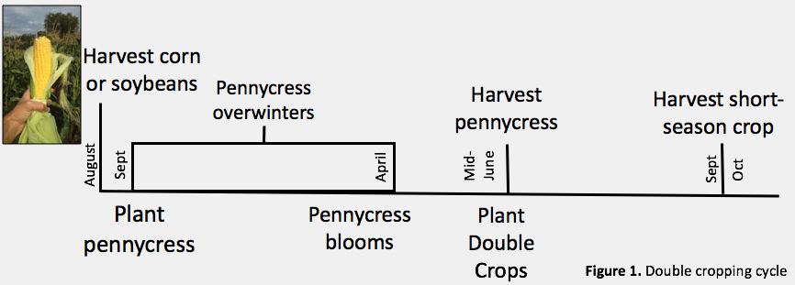
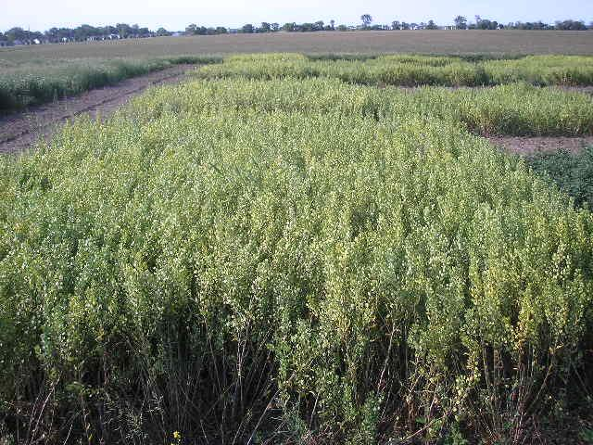
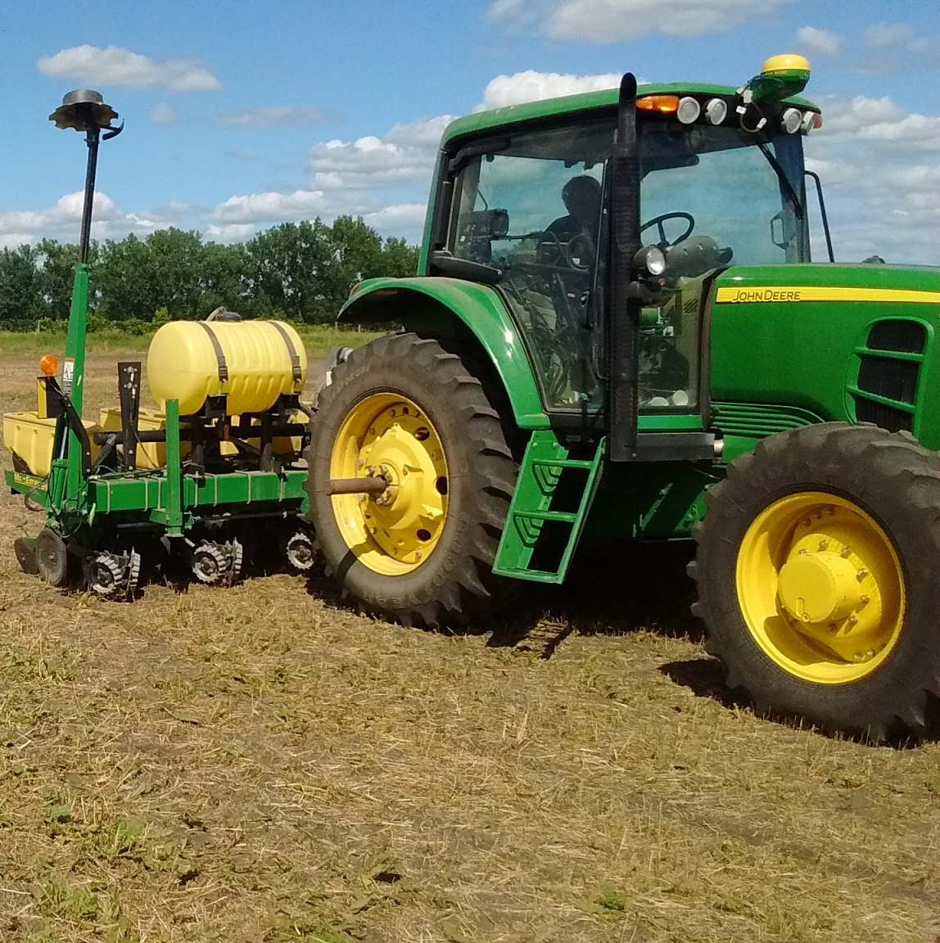
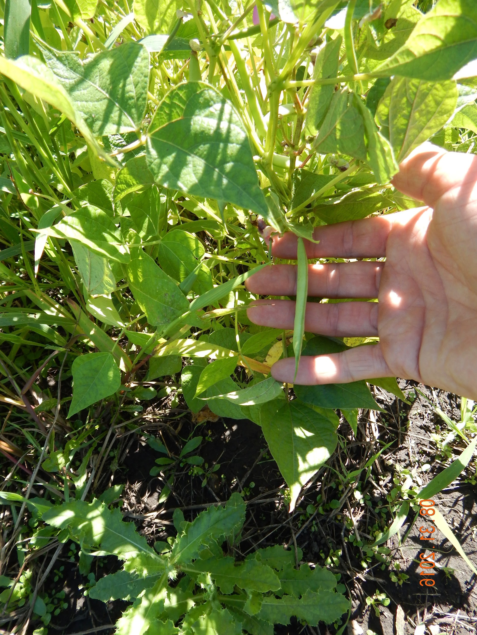
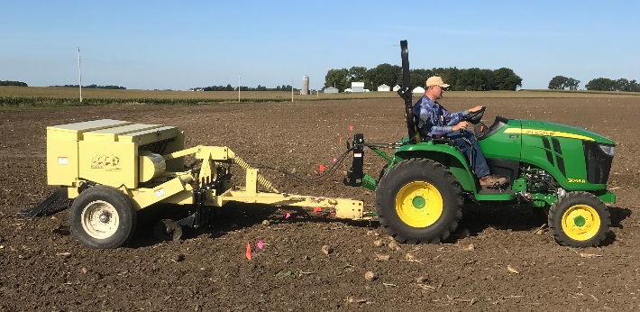
Double Cropping Timeline
Moore et al., 2017.

Slide 31

31

Slide 32
Weedy Characteristics
High relative growth rates
Inefficient resource use
Highly susceptible to shade
Accumulate nutrients and suffer nutrient deficiencies easily
Small seeded
Produce many seeds
Shed seeds, some highly mobile
Seed Dormancy
Germination stimulated by soil disturbance
32

Slide 33
Harvest Loss and Shatter (MN106)
78% Harvest Loss Relative to Total Oilseed Yield
34% Harvest Loss Relative to Total Oilseed Yield
Carlson et al., 2018

Slide 34

Harvest Timing (MN106)
Predicted pennycress grain yield at harvest in response to sampling date in
Morris and Rosemount, MN (2017).
Cubins et al., 2017.

Slide 35

Harvest Timing and Oil Content (MN106)
Predicted pennycress oil content at harvest in response to sampling date in Morris and Rosemount, MN (2017).
Cubins et al., 2017.

Slide 36

FALL OILSEED PLANTING
Drilled into prepared beds 1st week of September
Pennycress at 6 lb ac⁻¹ pure live seed
Camelina at 7 lb ac⁻¹ pure live seed
7.5 in spacing, ¼ in deep

Slide 37

Questions?
M. Scott Wells
Assistant Professor
Agronomy/Plant Genetics
UMN Twin Cities
Office Phone: 612-625-3747
mswells@umn.edu

Slide 38

Economics: Camelina and Soybean
Adapted from Russ Gesch. USDA-ARS.
38
Notes:
No significant differences in yield between cover crop species or planting techs at either location. Average yield at Lamberton was 177 bu/ac and at Waseca was 176 bu/ac. Minnesota average 188 bu/ac

Slide 39

Timeline
Aug.
May
June
Sept.
Oct.
Nov.
Mar.
Apr.
July
Aug.
Sept.
Oct.
Nov.
Direct Seed or no-till Oilseeds
Winter and Early Spring Cover Crop
Harvest Oilseeds
Harvest
Wheat,
Silage Corn, Sugar beet
Relay Cropping
No-till Soybean into Oilseeds
Harvest
Soybean
Double Cropping
No-till Short Season Soybean
Harvest
Soybean
Interseed Oilseeds in Corn
Winter and Early Spring Cover Crop
Harvest Oilseeds
Relay Cropping
No-till Soybean into Oilseeds
Harvest
Soybean
Harvest Grain Corn
Double Cropping
No-till Short Season Soybean
Harvest
Soybean
39

Slide 40


Feed Values
Notes:
No significant differences in yield between cover crop species or planting techs at either location. Average yield at Lamberton was 177 bu/ac and at Waseca was 176 bu/ac. Minnesota average 188 bu/ac

