Slide 1
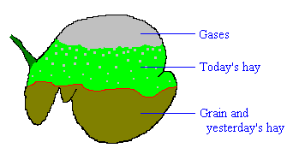
Ruminant Physiology
Think of rumen as a fermentation vat “on the hoof”
Microbes use fermentation process to break down complex carbohydrates (CHOs) such as cellulose to glucose, then convert to volatile fatty acids (VFAs)
Higher fiber in diet stimulates saliva production, which in turn increases VFA production
Ruminants get >70% of their energy from VFAs:
acetic, proprionic and butyric acids
Virtually all VFA absorption occurs in rumen
Slide Source: Rhonda Gildersleeve

