Slide 1
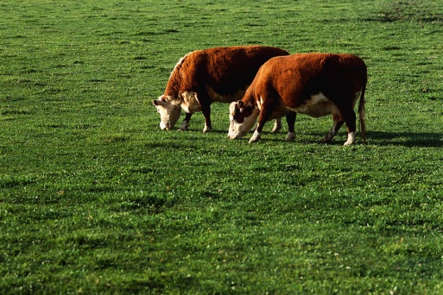
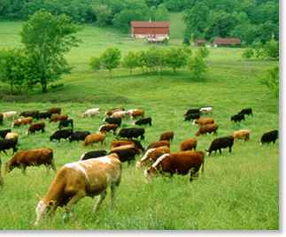
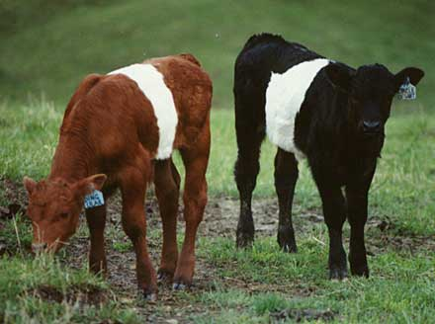
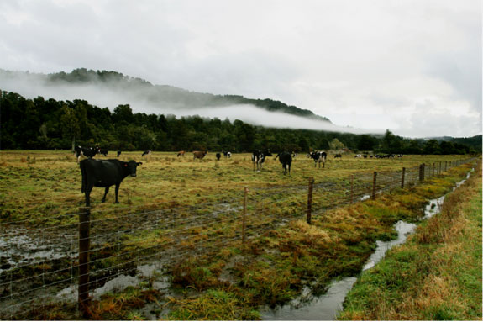
Pasture Dry Matter Intake Factors:
Palatability: how acceptable the forage “tastes” to the grazing animal
Nutritive value: amount of nutrients provided and how digestible they are
Availability: how much forage is offered
Our Goal: Maximize Pasture Dry Matter Intake to optimize animal performance
Slide Source: Rhonda Gildersleeve

