Slide 1
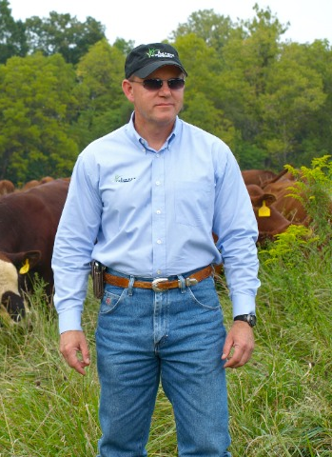
Allen Williams
Allen Williams is a 6th generation family farmer (since 1840) and founding partner of Grass Fed Beef, LLC and LMC, LLC. He has consulted with more than 3500 farmers and ranchers in the U.S., Canada, Mexico, and South America on operations ranging from a few acres to over 1 million acres.
Allen pioneered many of the early grass fed protocols and forage finishing techniques and has spent the last 15 years refining those. He is a “recovering academic” and has authored more than 300 scientific and popular press articles.
He is featured in the Carbon Nation film, “Soil Carbon Cowboys” (http://vimeo.com/80518559) and has a recently released book co-authored with Teddy Gentry, “Before You Have A Cow”.
Allen is a regular contributor to “GRAZE” and has written articles for the “Organic Broadcaster”, “Stockman GrassFarmer”, and many other publications.
He currently serves on the Board of Directors of the Grass Fed Exchange and the Mississippi Sustainable Agriculture Network, Core Team Member of the Pasture Project, and Co-Investigator for Team SoilCarbon. He also serves as an officer in the Starkville Civitan Club and is active in his local church.

