Slide 1
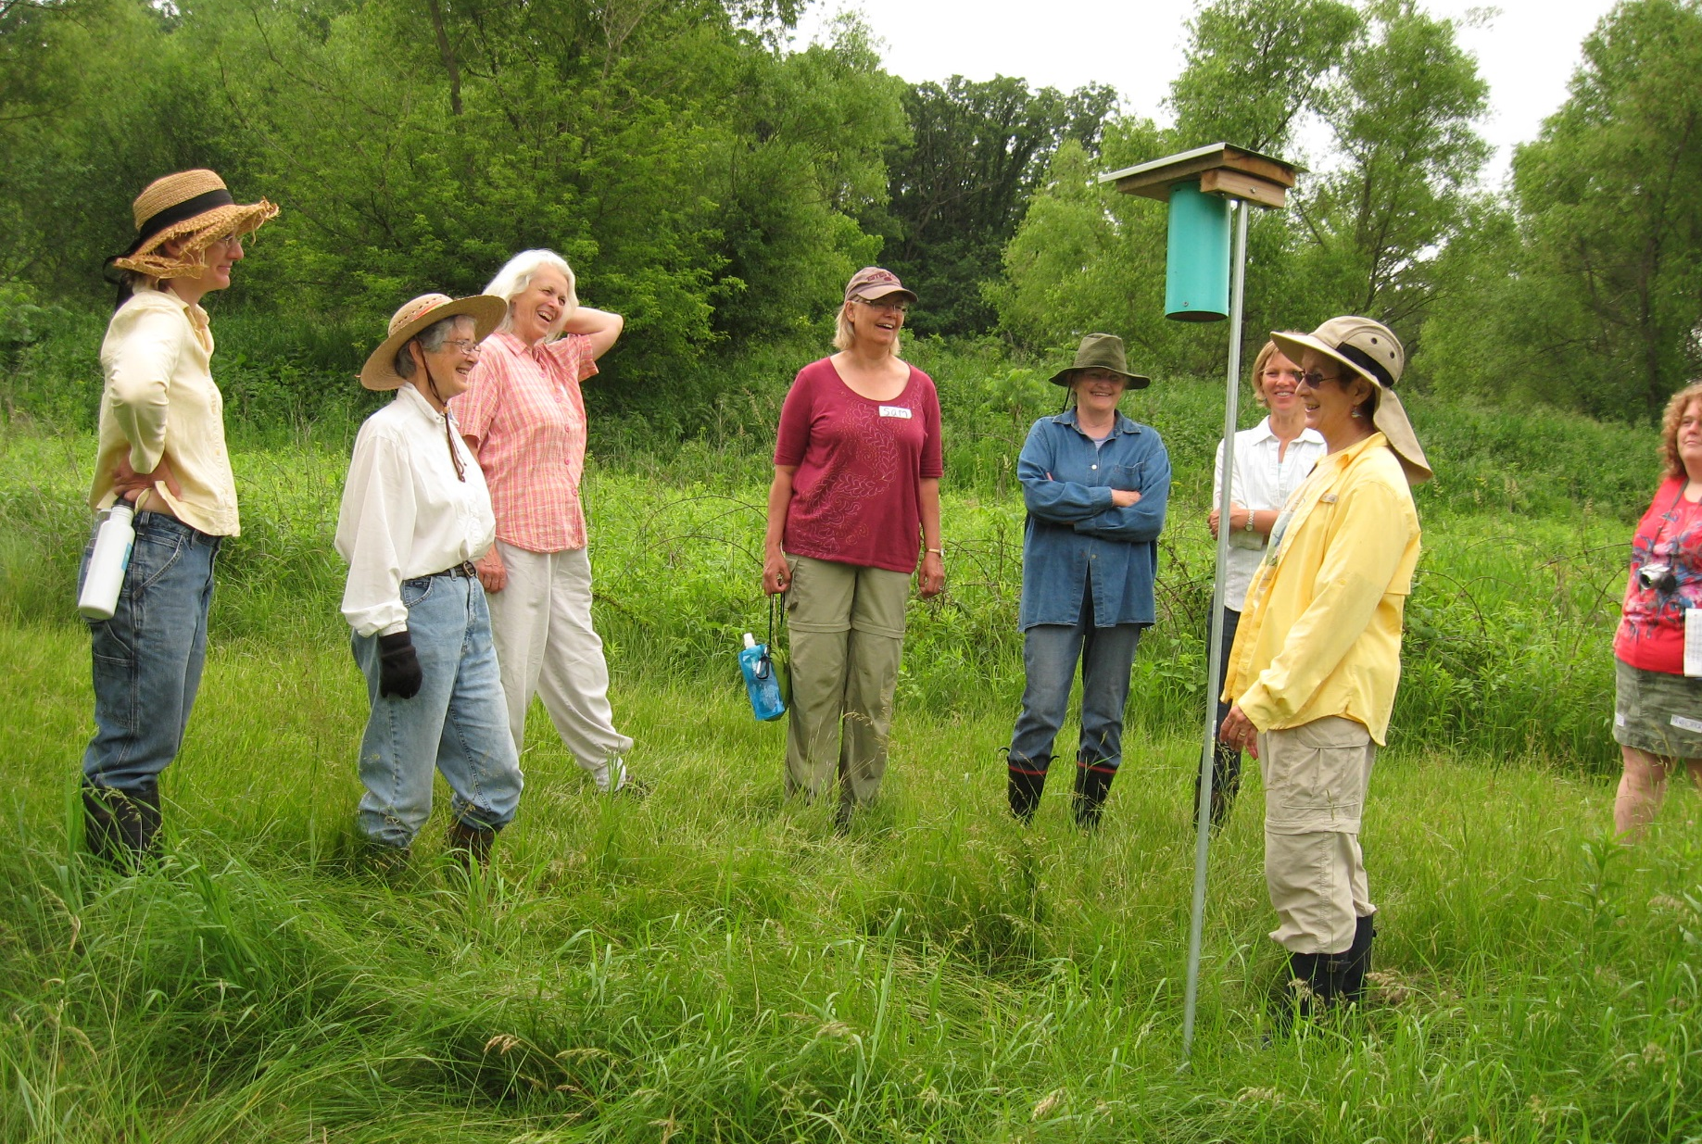
Slide Source: Caroline van Schaik
Notes:
They typically don’t speak what one woman called “farm-guy-ese” …
Some will have had off-putting experiences with ag professionals…
Or never set foot in an ag service center.

