Slide 1
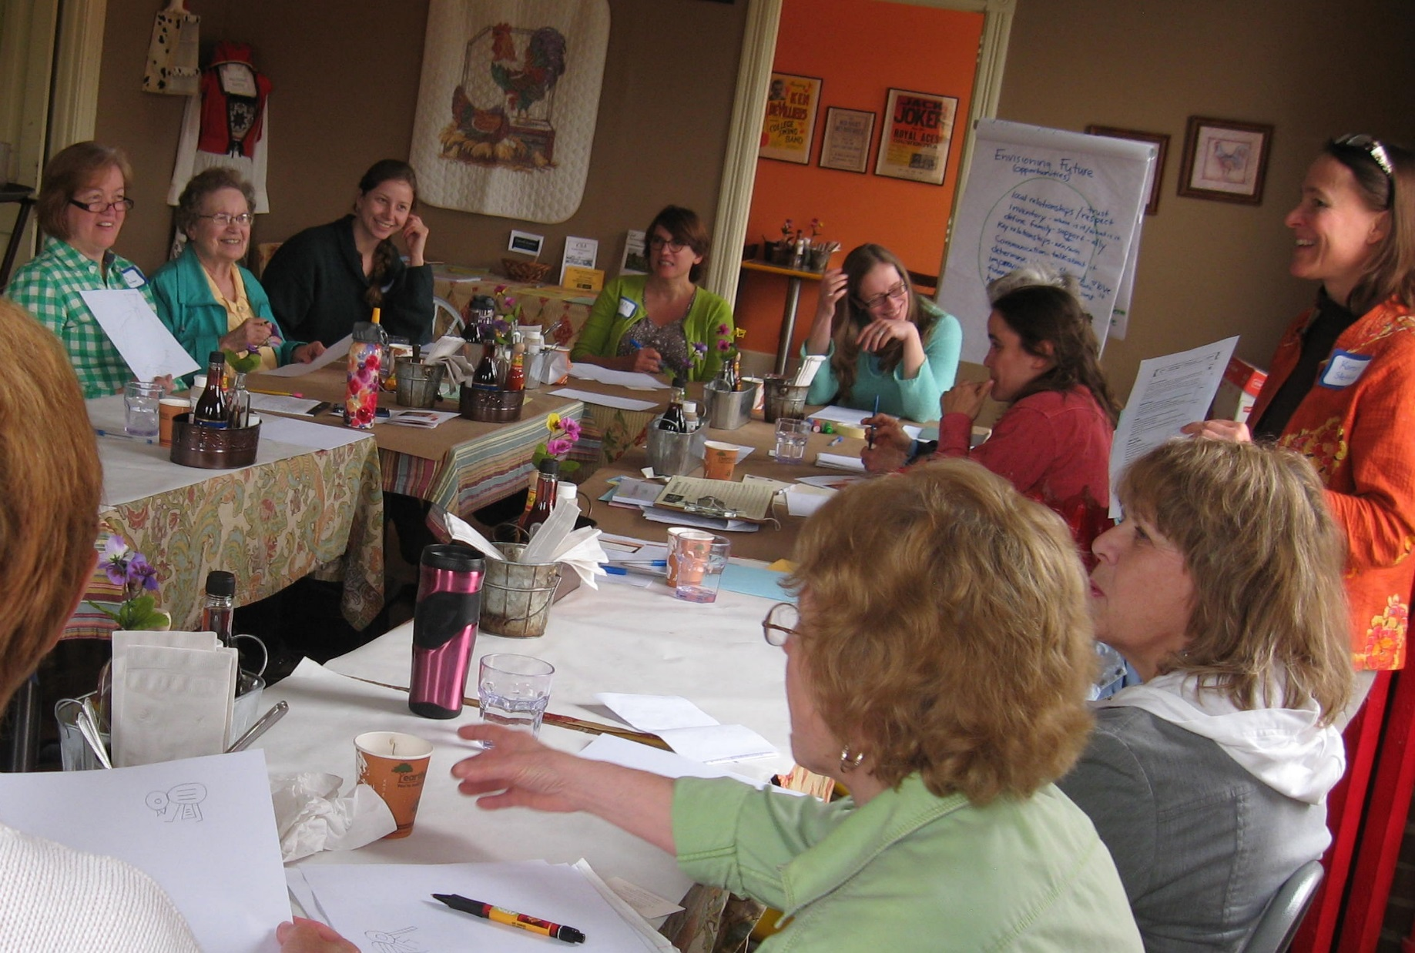
Slide Source: Caroline van Schaik
Notes:
These women have a desire to manage it well – even better - but many have very little or no experience making these kinds of decisions.
That was the role of their husbands, their grandpas or brothers, even long-time tenants.
But as land ownership shifts, women are emerging
as nascent keepers of the family acreage…
Managing family trusts and in-laws…
Siblings and children
And stepping up to learn in ways they never did in their growing up years.
They are often willing AND able to strike a different balance between management practices and profit…

