Slide 1
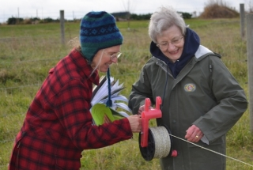
Slide Source: Caroline van Schaik
Notes:
They probably aren’t moving fence.
They do know the challenge of tenants…
The expectation to be nice...
(As though asserting their expectations for their land is anything else!)
And sometimes the fear of losing the guy who plows their driveway in winter
even if he plows over the grassy waterways in spring.

