Slide 1
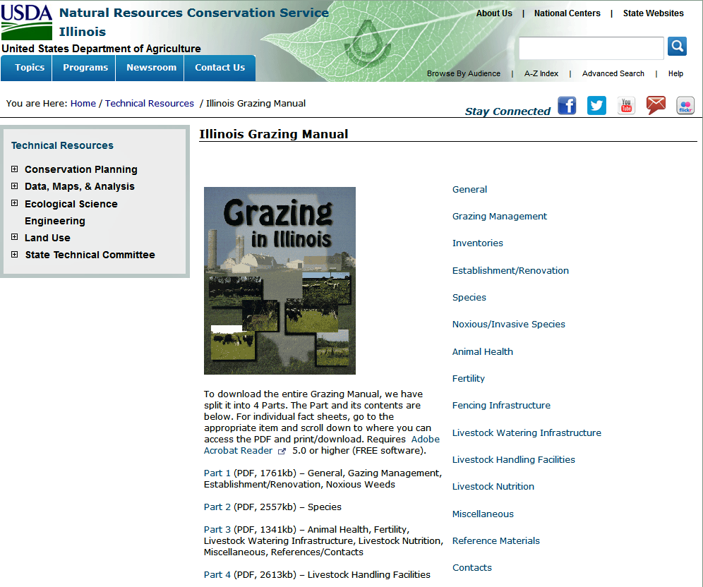
Slide Source: Doug Gucker
Notes:
http://www.nrcs.usda.gov/wps/portal/nrcs/detail/il/technical/?cid=nrcs141p2_030613

