Slide 1
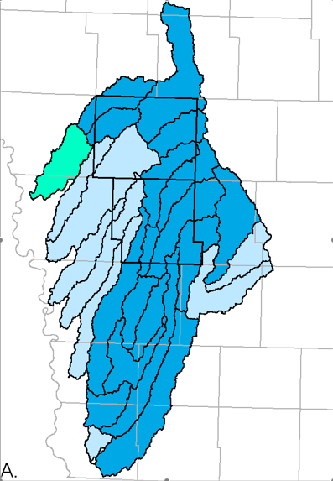
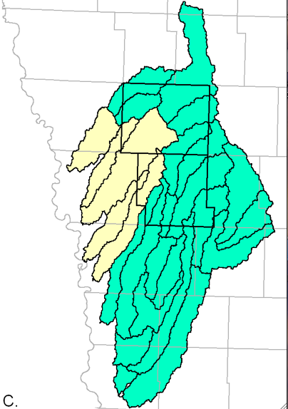
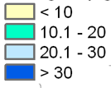
Predicted leachable soil nitrate-N concentrations for current and alternative land uses in western Iowa
Burkart, M., D. James, M. Liebman, and C. Herndl (2005), Impacts of integrated crop-livestock systems on nitrogen dynamics and soil erosion in western Iowa watersheds, J. Geophys. Res., 110, G01009, doi:10.1029/2004JG000008.
Current conditions
NO₃-N, kg/ha
Diversified and
integrated crop-
livestock systems
Median: 32 kg NO₃-N/ha
Median: 10 kg NO₃-N/ha

