Slide 1
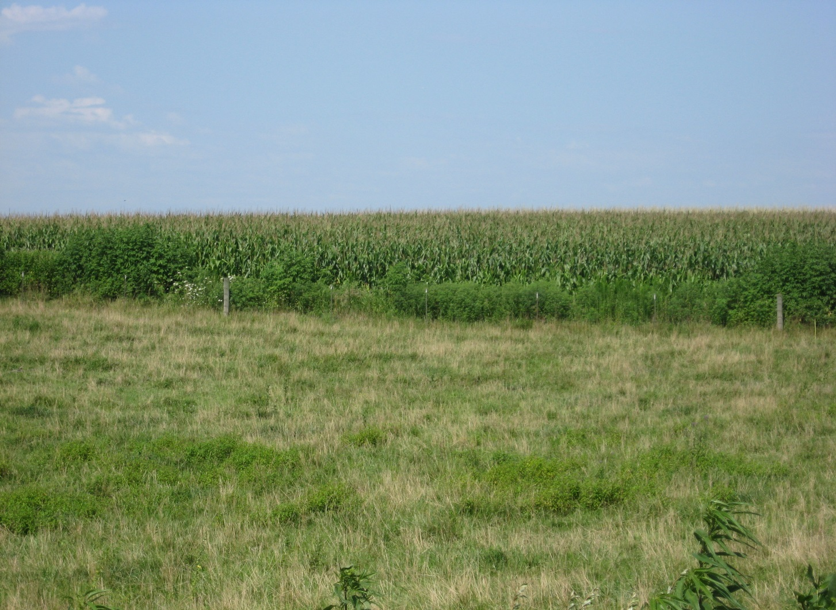
Midwest farms have combined pasture and row crops

