Slide 1
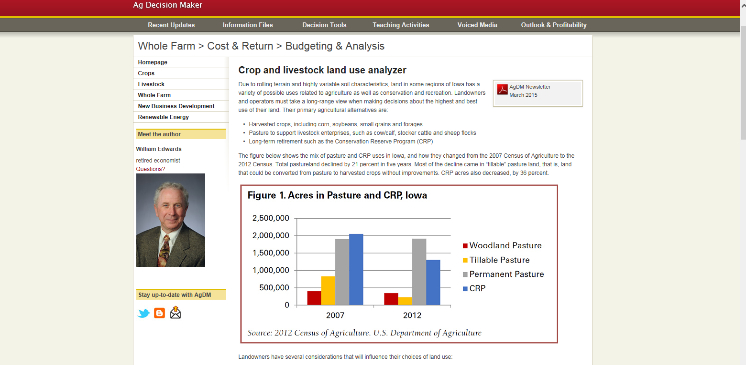
Land Use Analyzer http://www.extension.iastate.edu/agdm/wholefarm/html/c1-15.htm

