Slide 1
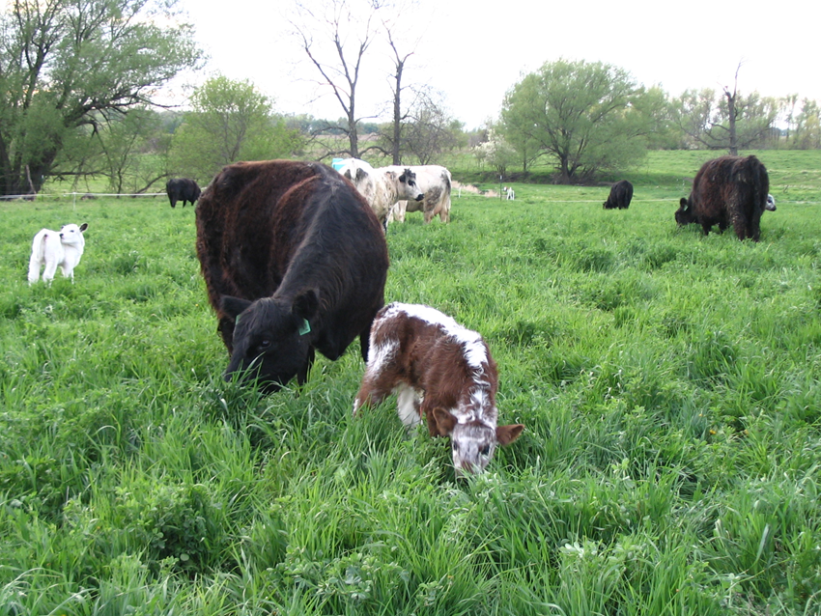
Pastures mimic natural systems
Soil bug wish list
Lack of disturbance
Consistent moisture
Consistent temperature
Consistent supply of oxygen
Consistent sources of nutrients
Less soil disturbance
More plant diversity
Living roots year-round
Continual soil cover
Building soil organic matter
Slide source: Laura Paine
Notes:
So what do soil bugs need to be happy? They mainly like consistency (moisture, temperature, oxygen, nutrients) and they don’t like disturbance, because that disrupts all of the above. Pasture, because it closely mimics natural systems, delivers all of these things. Perennial pasture maintains the soil undisturbed. Diverse pastures with living roots year-round provide a healthy habitat for soil microbes, keeping the soil covered and building soil organic matter.

