Slide 1
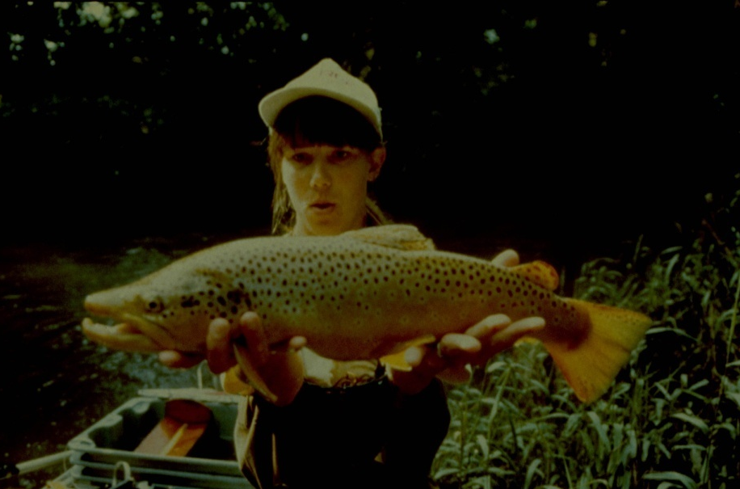
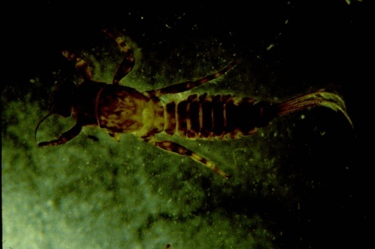
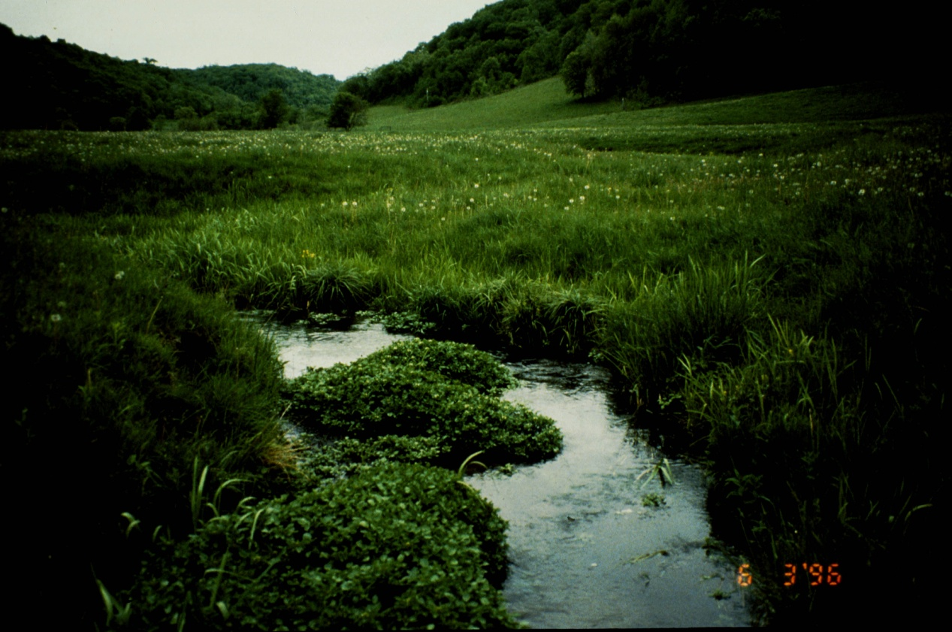
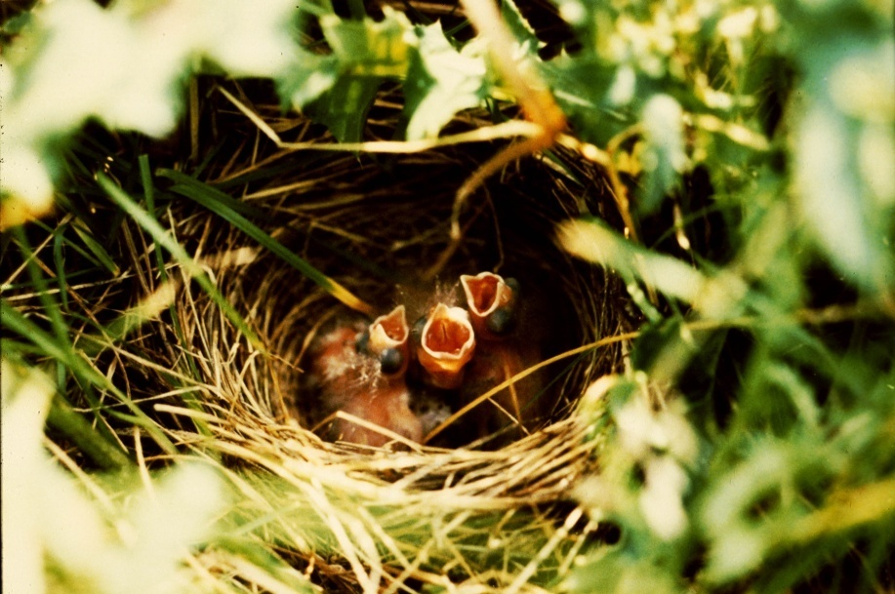
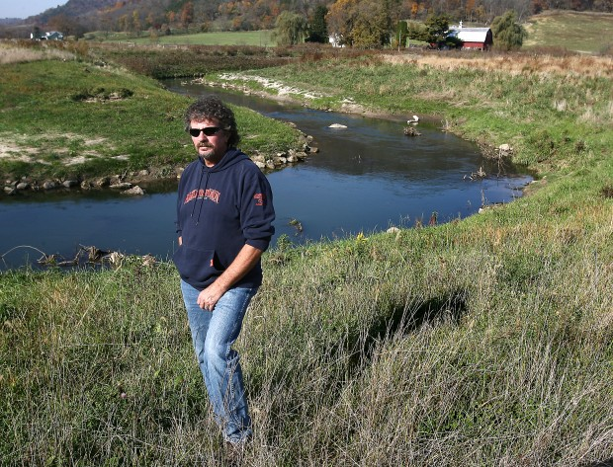
Managing grazing for habitat goals
Slide source: Laura Paine
Notes:
Now let’s turn to aspects of wildlife habitat quality. How do we managed the grazing animal to achieve habitat goals. We not only have lots of research showing that this can be done, but we have lots of experience with it. The man in the lower right-hand corner is Dave Vetrano, now retired from his job as DNR fisheries biologist in SW WI. He was responsible for managing trout fishing easements on private land throughout southwestern WI. He found that one of the most effective ways of controlling brush along these easements was by using cattle grazing.

