Slide 1
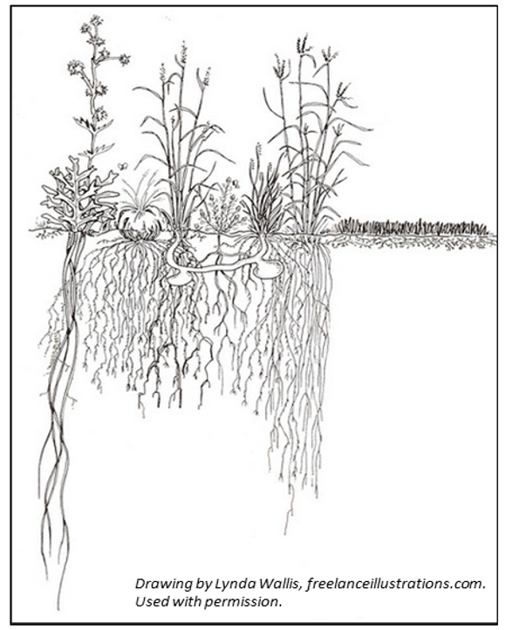
Microbe “Home” – Soil microbes live and function in root zone
Slide Source:
Allen Williams

