Slide 1
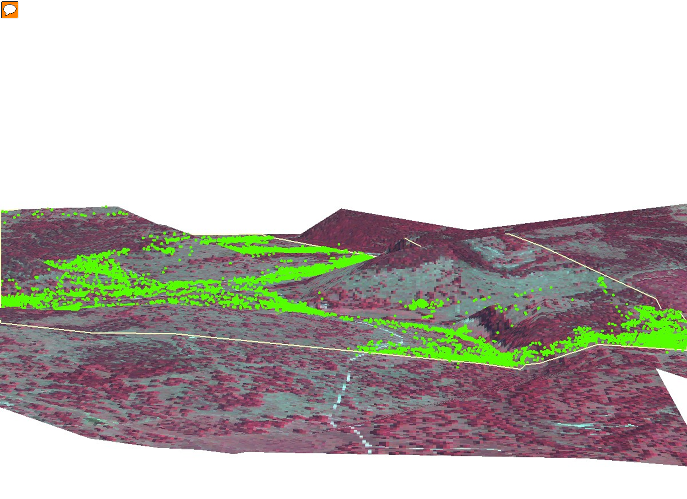

GPS Collared Cows – Grazing Study
West Texas Ranch
Continuous Grazing
Courtesy: R. Teague, TAMU
Slide Source:
Allen Williams

