Slide 1
Upper Midwest Grazing Educators Webinar Series
Teaching the Basics of Grazing
May 15, 2015

Slide 2
Hosted by Warren King and Jane Jewett
Co-manager of the Pasture Project
President of WellSpring, Ltd
Work focused on expanding environmentally sustainable farming, developing local & regional food systems and improving water quality
Research Fellow, University of Minnesota
Green Lands Blue Waters Initiative

Slide 3
Webinar Technical Orientation
Notes:
Welcome! This is a quick overview of the basic features of the cluster call software.

Slide 4
Your Starting Screen
Presentation
Control Panel
Notes:
Your screen should look something like this.

Slide 5
To Display Minimized Control Panel
Click the orange arrow button
Notes:
You’ll want access to your control panel during the presentation, so if it is minimized, click the double arrow button.

Slide 6
To Keep Control Panel Visible
Notes:
To keep the control panel visible, go to the View menu …

Slide 7
To Ask a Question
Type your question in the small box at the bottom of the Questions box.
If possible, specify which panelist(s) you are addressing with your question.
Press “Send”!
Notes:
To interact with the panelist(s) or tech support, use the Questions box. Most questions will be addressed after the formal presentation during the Q&A time, but if you need clarification on a point, or have technical difficulties, ask at any time.

Slide 8
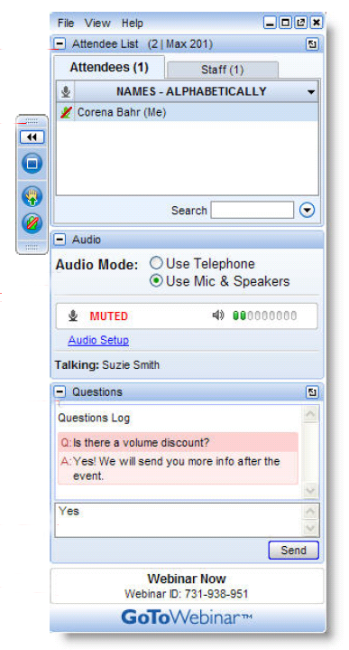
To “Raise Your Hand”
Notes:
To interact with the panelist(s) or tech support, use the Questions box. Most questions will be addressed after the formal presentation during the Q&A time, but if you need clarification on a point, or have technical difficulties, ask at any time.

Slide 9
Post-Webinar Survey
We will be sending out a survey following the webinar.
These surveys help to make for a better experience for everyone involved, if you could please take a moment to fill them out, it would be of great help to us.
Notes:
At the conclusion of the Cluster Call your browser will open showing a very brief survey. Please take a minute or two to fill it out so that we can continue to make the Cluster Calls a valuable service to you.

Slide 10
Who’s Sponsoring the webinar series?
Green Lands Blue Waters
The Pasture Project
Goals
Increase perennial forage and pasture
Improve environmental performance of farming
Maintain production and profitability
Goals
Expand grass-based livestock production
Accelerate transition to sustainable farm production
Improve water quality

Slide 11
Why Focus on Grazing Educators?
The Upper Midwest is a unique geography
More young farmers are interested in livestock production
More landowners and conservationist are interested in livestock benefits
More consumers want pasture raised meat and dairy products
Less public funding for grazing networks and education
Fewer professional development opportunities for educators
Changes in grazing techniques and terminology
No single source for education materials

Slide 12
What Could a Grazing Educator Network Achieve?
Connect Upper Midwest Educators through discussion and sharing
Assess education materials-tool; determine what’s missing and fill the gaps
Create a platform to house and access materials and tools
Share what works and why
Cross-pollination of staff, students, apprentices and programs
Involve established grazing education programs
Access materials-tools no longer in circulation
Build collaboration that is more “grass-roots” than “top-down”
Include educators of various types; farmers, academics, agency and consultants
Establish basic principles of managed grazing that are taught by all

Slide 13
What is the format for today’s webinar?
Presenters will discuss topics, sharing experience and insights
Audience is encouraged to do the same
Moderators will “direct the traffic” and keep discussion moving
Audience is asked to take a brief survey at the end of the webinar

Slide 14
Andy Marcum
Andy Marcum is the Ag Lands Solutions Specialist for the Land Stewardship Project. His work focuses in the Chippewa River Watershed on the Chippewa 10% Project, a cooperative effort focused on increasing perennial cover throughout the watershed.
Growing up on a Hereford Ranch in Oregon, Andy has gained an extensive background in cattle and grassland management.
Currently Andy works with various landowners to improve production and profitability on their property
Andy also raises Grassfed Beef on his own ranch using intensive grazing management to restore degenerated pasture and Native Prairie.

Slide 15
Laura Paine
Laura Paine has been involved in Wisconsin’s sustainable agriculture community in a variety of roles for more than 20 years.
From 2006 to 2014, she served as Grazing & Organic Agriculture Specialist for the Wisconsin Department of Agriculture, Trade and Consumer Protection.
Paine is currently Program Director for the Dairy Grazing Apprenticeship, a formalized, nationally accredited training program for beginning dairy farmers.
She has a Bachelor’s Degree in Botany from Southern Illinois University, a Master’s Degree in Horticulture from the University of Wisconsin, and is a Certified Educator for Holistic Management International.
She and her husband raise and direct market grass-fed beef on their farm near Columbus, Wisconsin.

Slide 16
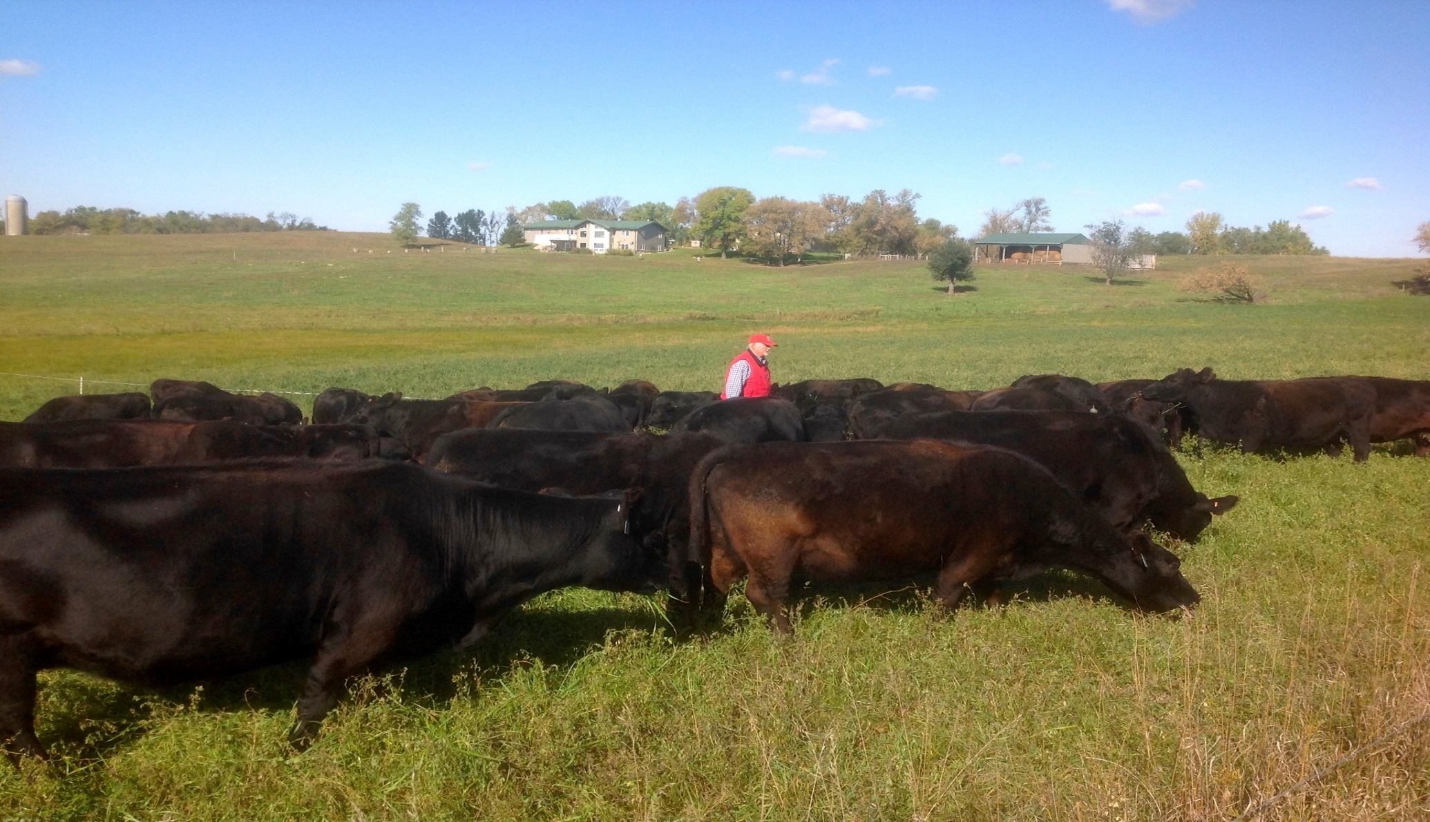
Conservation and the Environment on the Grazing Farm:
Grassroots Success in Landscape Level Change
Andy Marcum &
Laura Paine

Slide 17
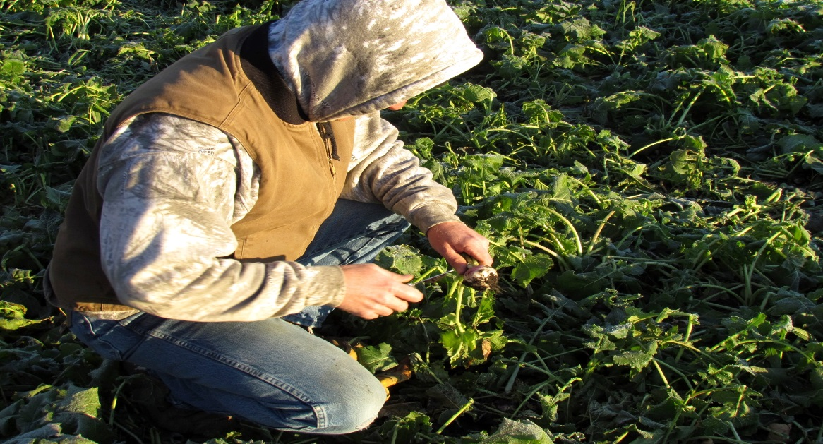
Land Stewardship Project
Mission- Foster an ethic of stewardship for farmland, to promote sustainable agriculture and to develop sustainable communities.
Landowner Engagement- Meet with farmers and landowners individually and spend time in a 1-1 setting. We discuss conservation goals, help recognize and verbalize obstacles to those goals, then form a plan to overcome these obstacles.
Chippewa 10% Project- Work with farmers and landowners to improve water quality throughout the watershed.
Perennial Cover
Cover Crops
Soil Health Monitoring
Input Reduction
Managed Grazing

Slide 19
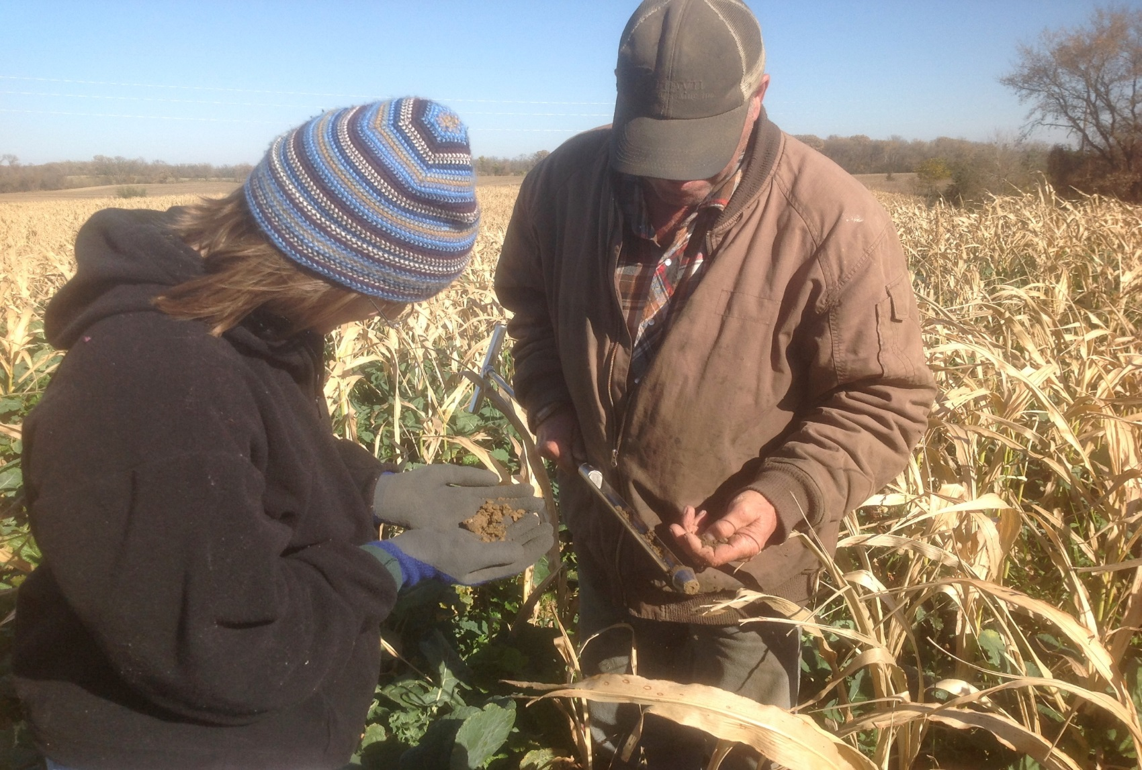
Success of Engagement; Networks & Individual Change
Meet landowners on their turf

Slide 20
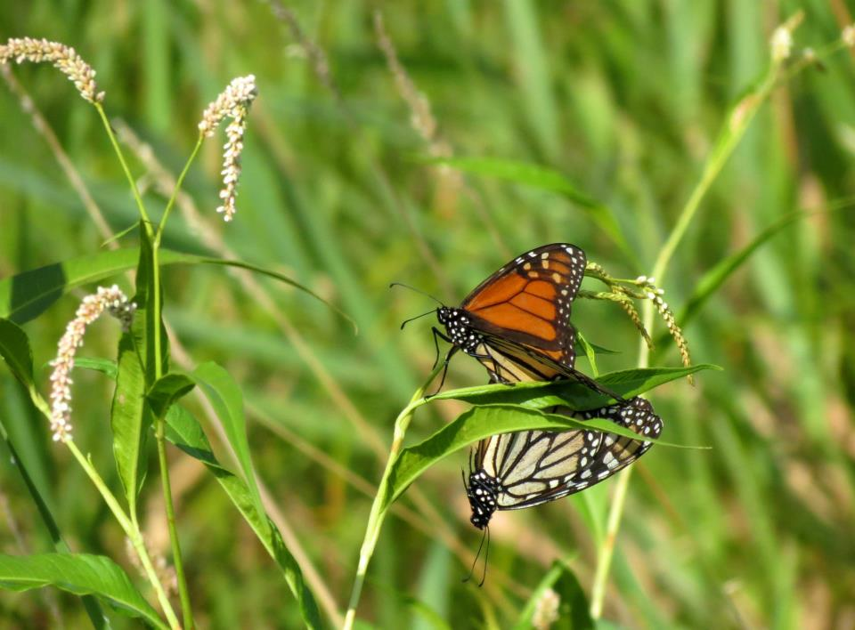
1-1 Conversations
Their History?
Farm History?
What are they proud of?
What they would like to see on their farm?
Changes in the community?
Conservation Goals?
Stating these values provides us with an opportunity to support action.

Slide 21
Formation of Networks

Slide 22
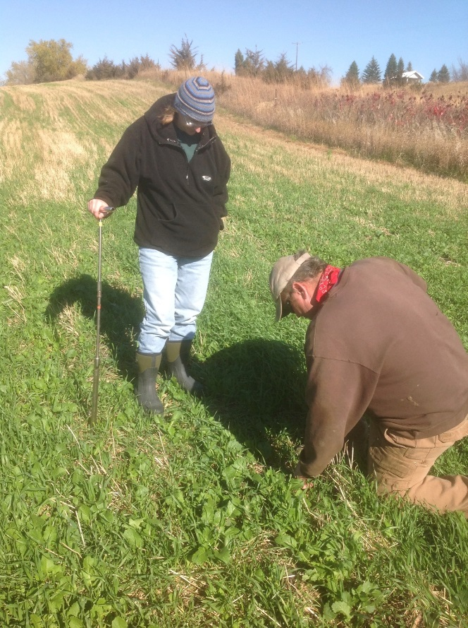
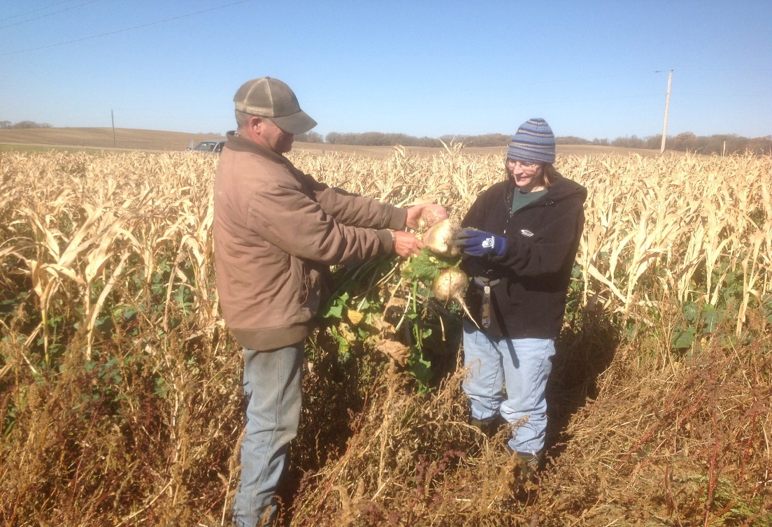
Cover Crop/Soil Health Network
Incentivize Initial trials
Connect farmers to resources
Provide opportunities for farmers to work together
Provide soil monitoring. Spring and Fall testing

Slide 23
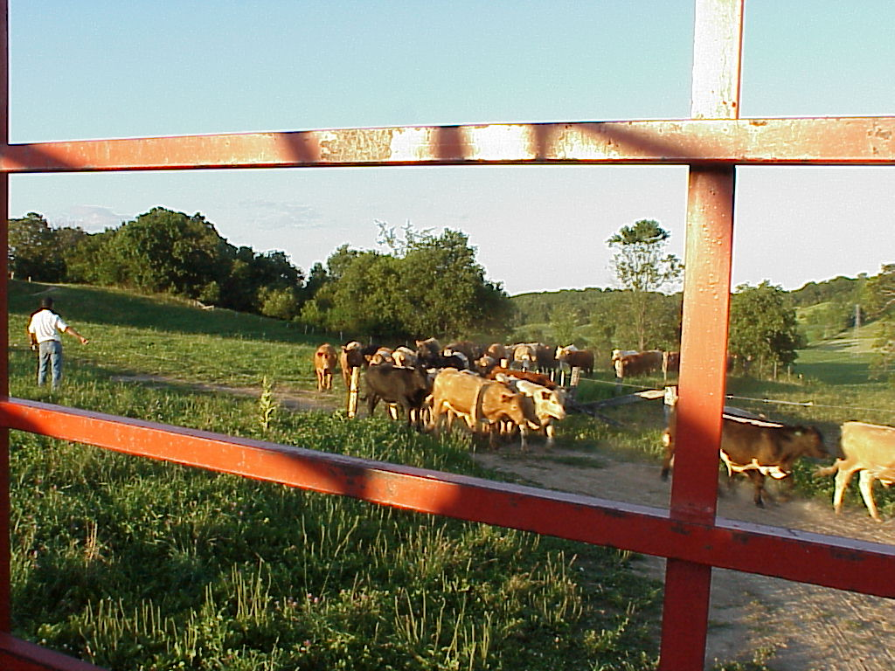
The nuts and bolts of Grazing for Conservation and Soil Health
Laura Paine
Program Director
Dairy Grazing Apprenticeship
608-338-9039
lkpaine@gmail.com
GLBW Grazing Educators Webinar
September 11, 2015
Notes:
Intro slide: We’ve talked about the basics of working with non-farming landowners and how to engage with our audience. Now we will turn to some details of how to manage grazing to achieve conservation results.

Slide 24
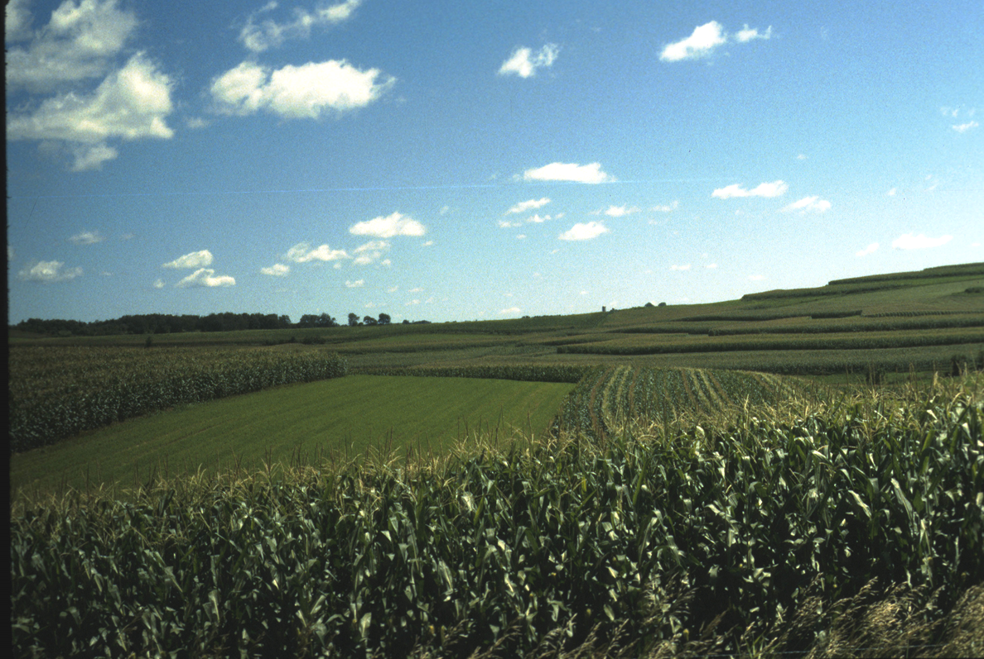
Mission: To support development of and transition to a new generation of agricultural systems that integrate more perennial plants and other continuous living cover in the agricultural landscape
Notes:
I’d like to first put in a plug for the Green Lands Blue Waters regional project. We are a collaborative of non-profit conservation and agriculture organizations, universities and individuals who are focused on the perennialization of agriculture with the goal of improving the environmental performance of our agricultural system. We have distilled that concept down to the phrase: continuous living cover. There are a number of ways of achieving that, but pasture is one of the most effective.

Slide 25
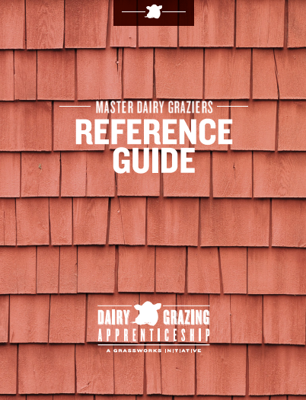
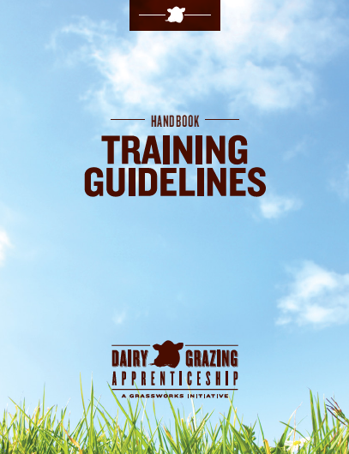
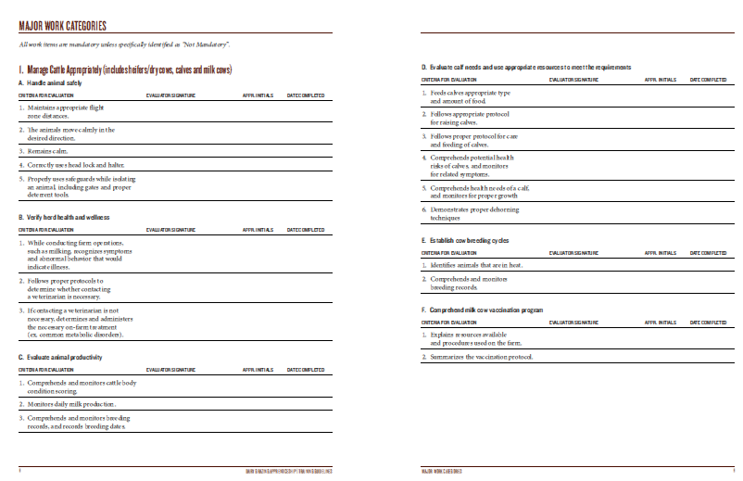
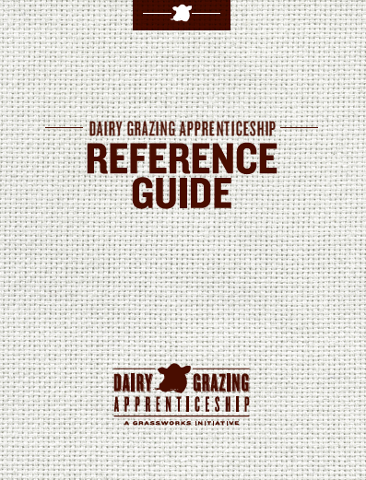
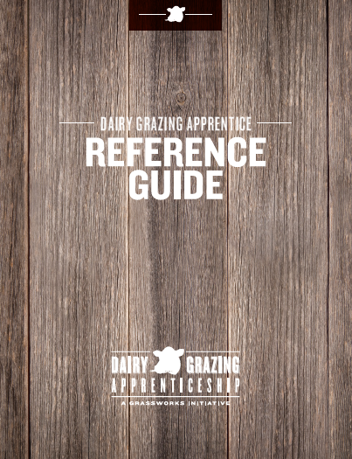
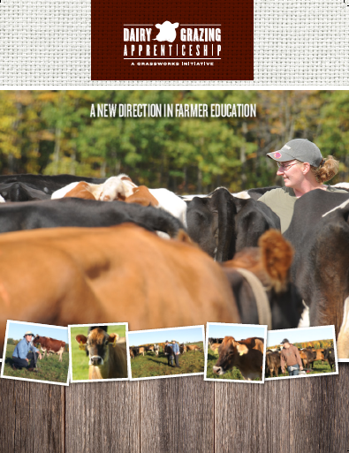
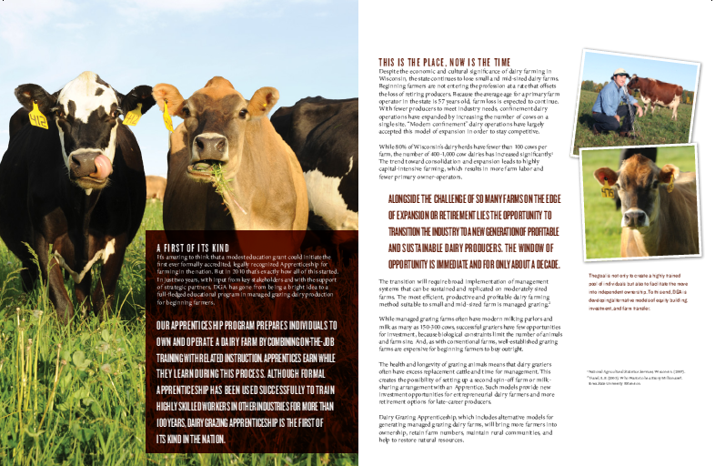
A Conservation Farming Apprenticeship
2 year program.
3712 hrs. on-the-job training on a working dairy farm.
288 hrs. related classroom instruction.
Notes:
I’d also like to put in a quick plug for my organization. The Dairy Grazing Apprenticeship is a two year formal training program for beginning dairy farmers. We utilize pasture based system for our training program because it is the most effective way to both economically produce milk and protect the environment.

Slide 26
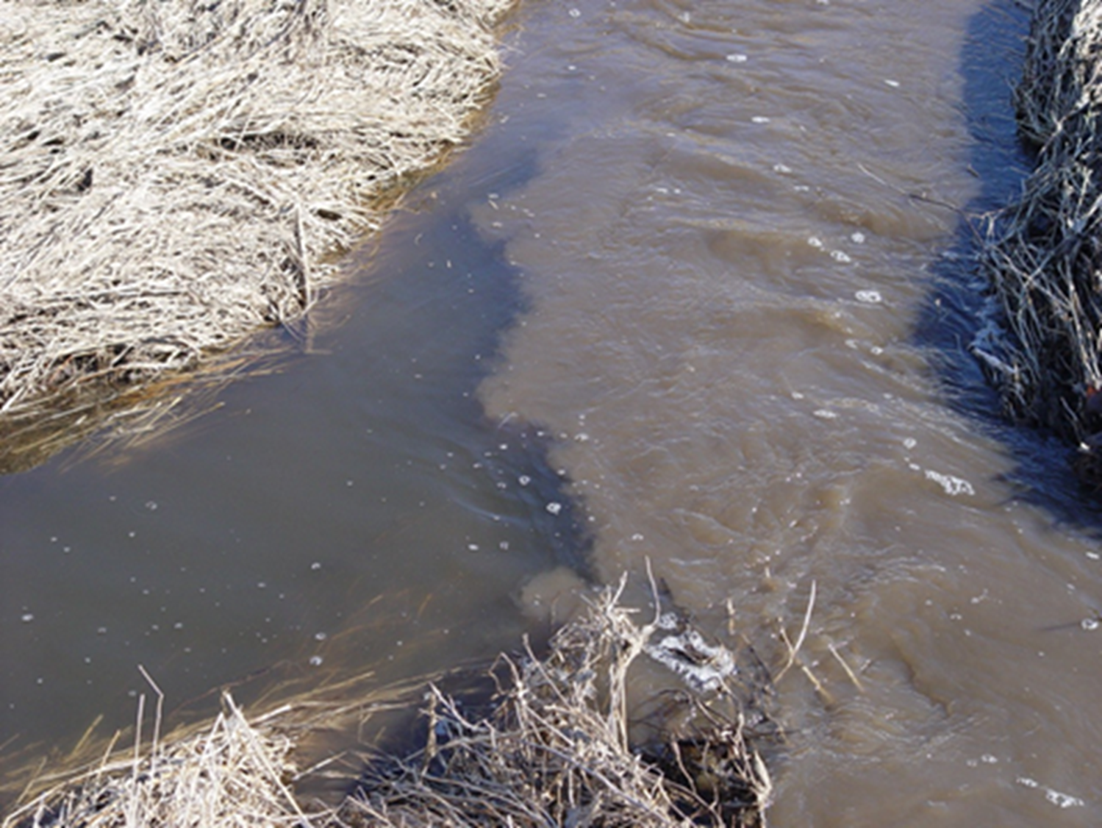
Why continuous living cover? Land….Water…Wildlife
Notes:
By promoting continuous living cover, we can achieve the goals of improving soil health and productivity, protecting water quality, and providing high quality habitat. By doing this we can also promote a culture of land stewardship was once strong, and needs to be revived.

Slide 27
Considering grazing as a habitat management tool
Restore something approaching natural grazing component and nutrient cycling
Increasing cost of other management tools (mowing, burning, etc.)
Livestock can go places where equipment cannot
Opportunity to partner with neighboring farmers
Other?
Notes:
For those landowners who are perhaps conservation agencies, or maybe non-farmers with conservation goals, or even farmers who are concerned with stewardship issues, we can start with looking at those goals that Andy was discussing. Why would you want to consider utilizing managed grazing on a conservation property?

Slide 28
Pastures keep soil in place data from Breneman Discovery Farms project
Sediment losses from Breneman outwintering pastures
Notes:
Over the next few slides, we will review some of the research that has been conducted that document the benefits of well managed pasture. First and foremost, we know that it is very effective at minimizing soil erosion. These are data from a statewide, on-farm research program in WI called Discovery Farms. This slide summarizes soil erosion from actual farm fields including a corn-soybean rotation (dark red), a dairy rotation including alfalfa (purple). The bars that are barely visible, indicated by the arrow, are runoff numbers from outwintering pastures on a grass-based dairy. The orange bar is the Rusle2 prediction of soil erosion from those pastures and as you can see, the actual pastures performed better than the prediction.

Slide 29
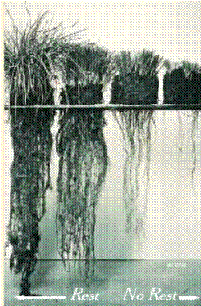
Over Grazed
Well Rested
Notes:
The great thing about managed grazing is that the same practices that result in better productivity also result in improved environmental performance. The rest rotation cycle is key to both. As you increase the rest period, the grass plant’s root system has a chance to regrow as well, restoring energy reserves and helping hold the soil in place.
This slide shows well rested grass plants on the left and overgrazed plants on the right that have not had enough rest. The plants on the left have much more stored energy in the roots. Their roots go deeper into the soil, allowing them to access water and nutrients that are not available to the overgrazed plants.

Slide 30
Rotational Grazing Principles for Production AND Conservation
Optimizing grass growth.
Pasture area is divided into paddocks.
Herd is rotated through a series of paddocks, remaining in each for 1 to 3 days.
Adequate residual is left to promote fast regrowth.
Each paddock is rested for 3 to 5 weeks.
Productivity and quality are maximized.
Thick, healthy pasture increases intake.
Notes:
Grazing expert Jim Gerrish boiled it down nicely into four keys that improve the performance of pastures. Rotation protects the pasture from overgrazing and soil damage. Leaving adequate residual allows for quick regrowth and protects from soil erosion. And rest, allows the sod to recover and restore energy reserves before the herd is returned to the paddock. All of these protect the environment, just as they increase intake and pasture utilization.

Slide 31
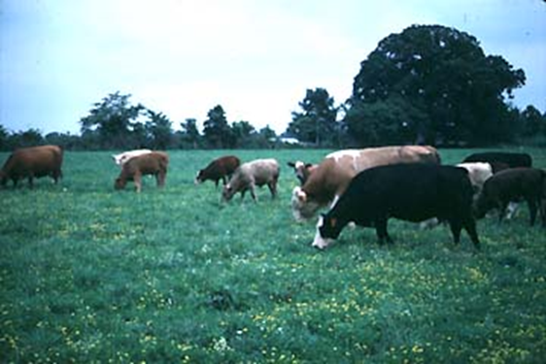
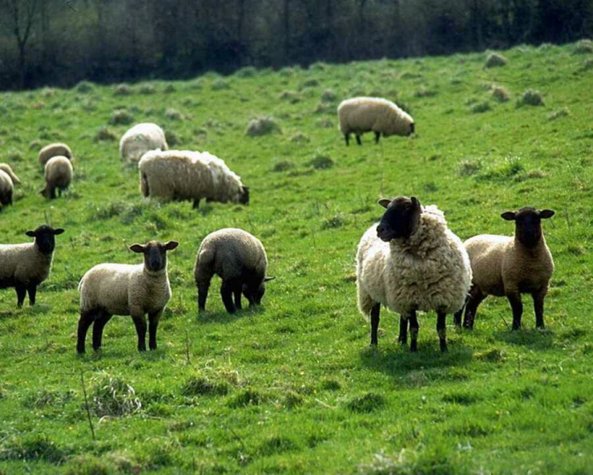
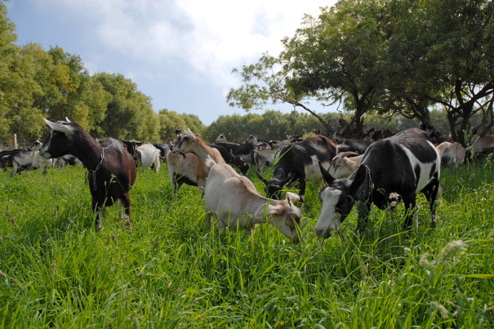
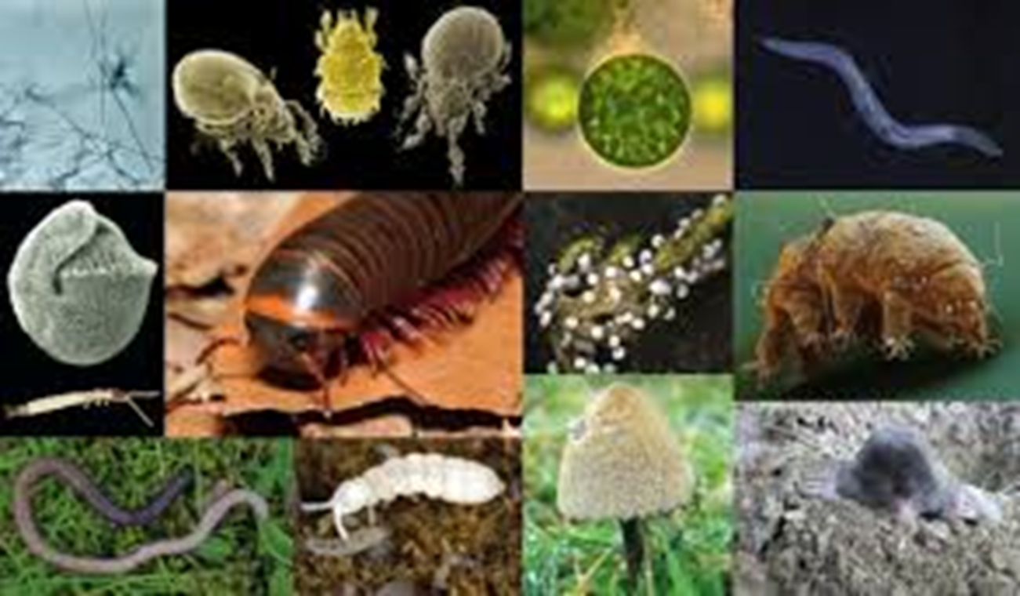
Livestock
Soil Livestock
Notes:
Let’s talk a little more about the soil. Controlling erosion is important, but we are becoming more aware that that is not enough. Soil health is important to the long-term sustainability of our farming systems. We need to be concerned not only about what our aboveground livestock are doing, but also about how healthy our soil livestock are.

Slide 32
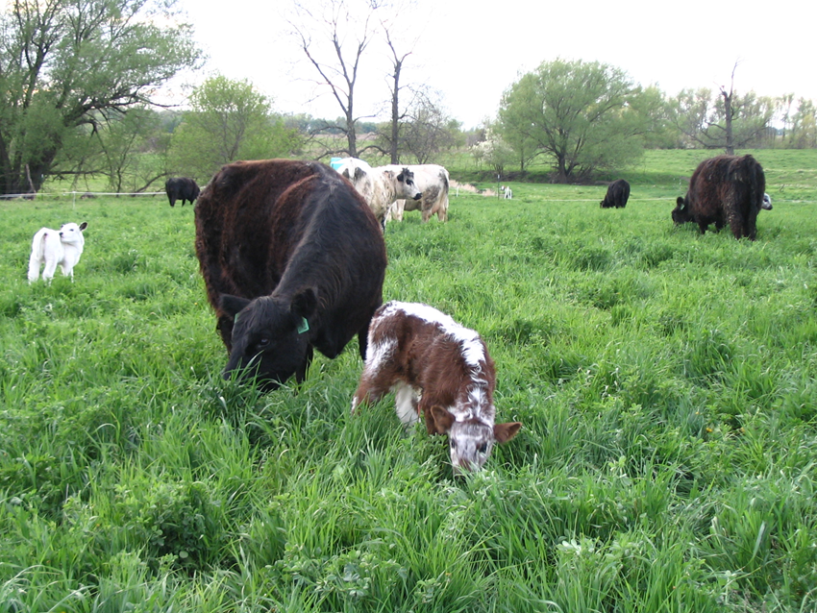
Pastures mimic natural systems
Soil bug wish list
Lack of disturbance
Consistent moisture
Consistent temperature
Consistent supply of oxygen
Consistent sources of nutrients
Less soil disturbance
More plant diversity
Living roots year-round
Continual soil cover
Building soil organic matter
Notes:
So what do soil bugs need to be happy? They mainly like consistency (moisture, temperature, oxygen, nutrients) and they don’t like disturbance, because that disrupts all of the above. Pasture, because it closely mimics natural systems, delivers all of these things. Perennial pasture maintains the soil undisturbed. Diverse pastures with living roots year-round provide a healthy habitat for soil microbes, keeping the soil covered and building soil organic matter.

Slide 33
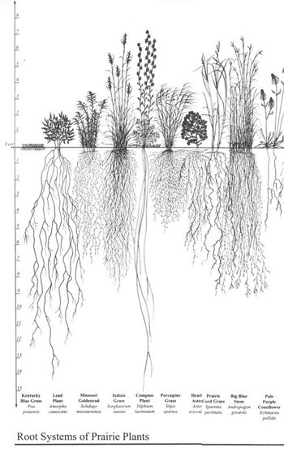
Diverse pastures increase intake
Plant competition
Water
Nutrients
Light
Space
Diversity enhances resource use efficiency
Notes:
Here again, we find that the same things that increase productivity in pastures, can also contribute to soil health. A number of studies have found that diverse mixtures actually increase the capture of sunlight and the productivity of the pasture sward.

Slide 34
Forage Yield in simple and complex mixtures
Data from Skinner et al. 2006 Agronomy J.
Notes:
These data are from a series of studies conducted at Penn State. The studies compared binary pasture mixtures with multi-species mixes with 9 or 11 species. This slide shows that under both grazing and haying management, the 11-species mix produced more forage than the 2 species mix.

Slide 35
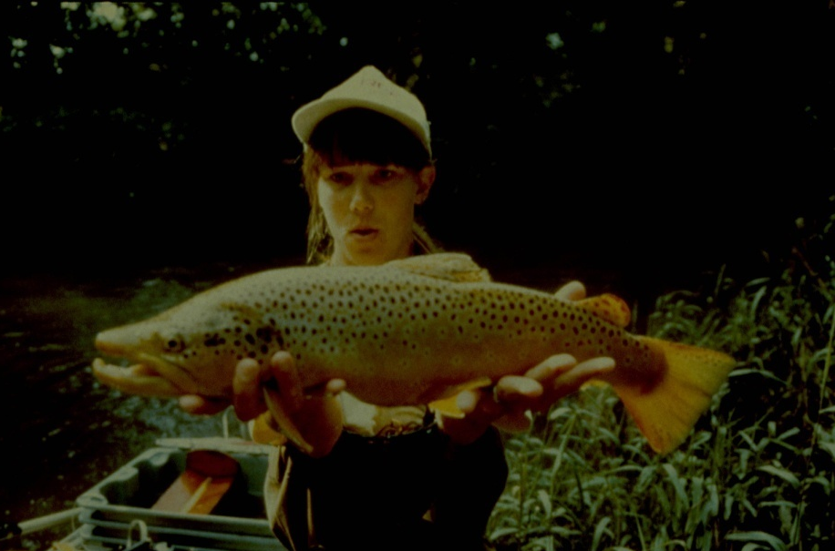
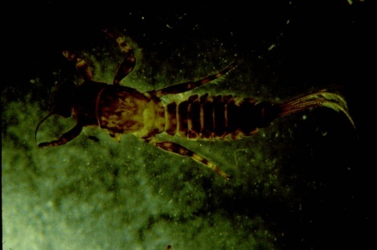
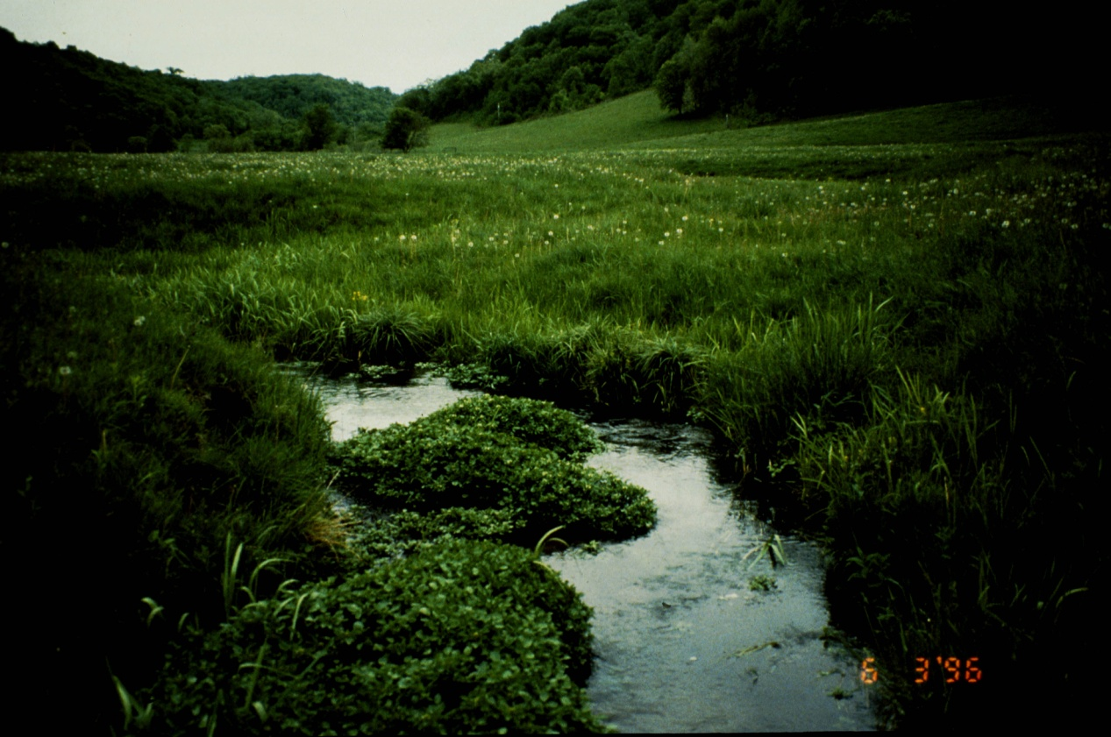
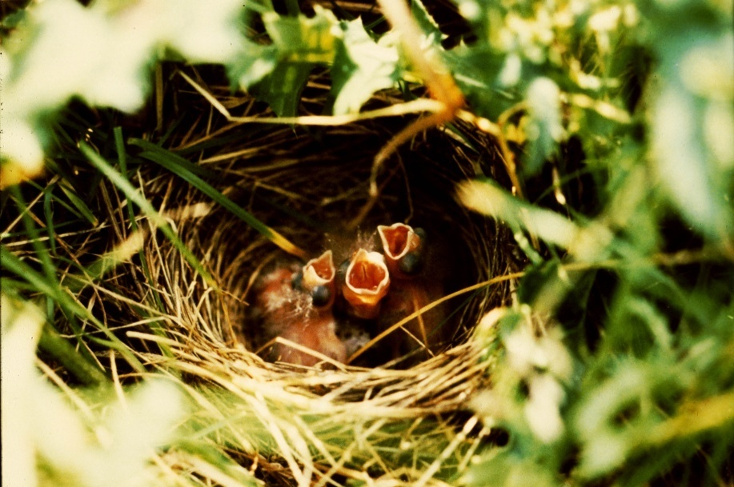
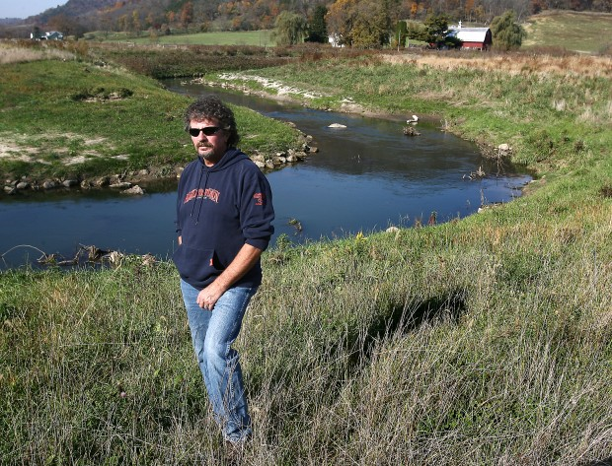
Managing grazing for habitat goals
Notes:
Now let’s turn to aspects of wildlife habitat quality. How do we managed the grazing animal to achieve habitat goals. We not only have lots of research showing that this can be done, but we have lots of experience with it. The man in the lower right-hand corner is Dave Vetrano, now retired from his job as DNR fisheries biologist in SW WI. He was responsible for managing trout fishing easements on private land throughout southwestern WI. He found that one of the most effective ways of controlling brush along these easements was by using cattle grazing.

Slide 36
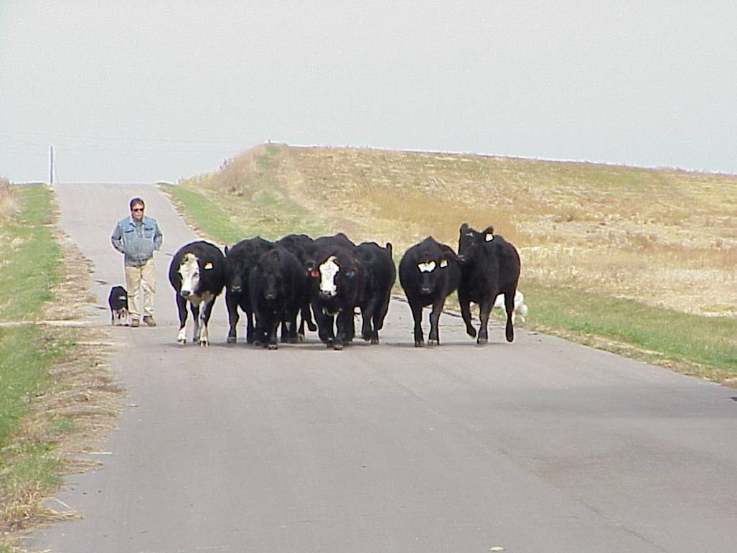
Goal: Have the right animals at the right place at the right time for the right reasons

Slide 37
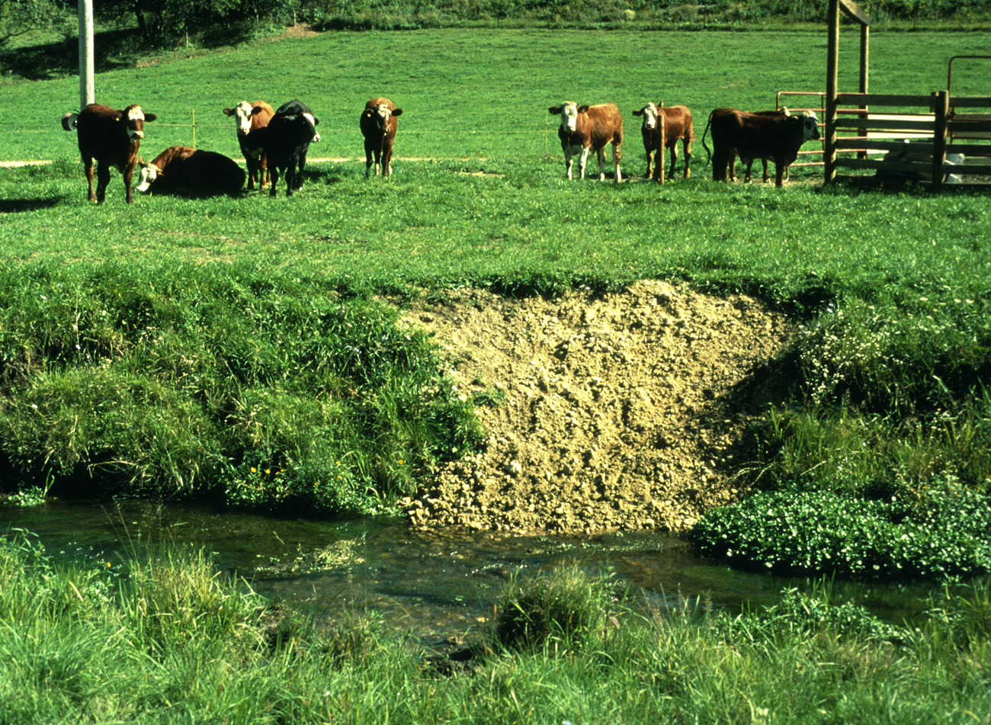
Improving Aquatic Habitat
Notes:
These are results from a study we did with Dave and others in the DNR. We looked at 20 trout stream reaches in SW WI and compared continuous grazing, managed grazing, grassy buffer strips and woody buffer strips. For bank erosion, it was not surprising that the unrestricted grazing resulted in the greatest amount of bank erosion. The surprising thing was that woody buffers had the second highest amount and that MIG created conditions similar to grassy buffer strips. For in-stream habitat (pools, riffles, substrate, channel depth and width, etc.), MIG again came out similar to grassy bufferstrips and better than woody bufferstrips.

Slide 38
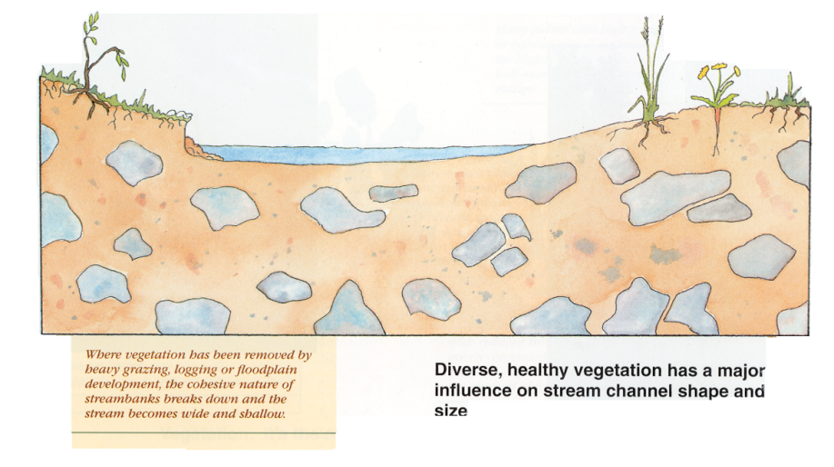
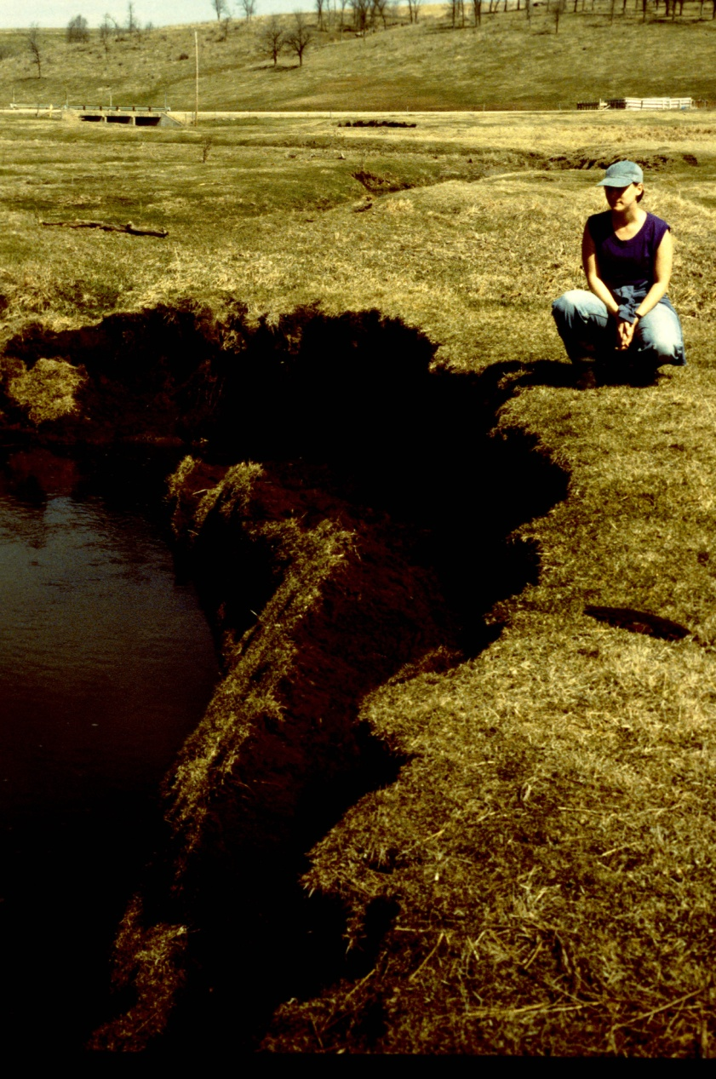
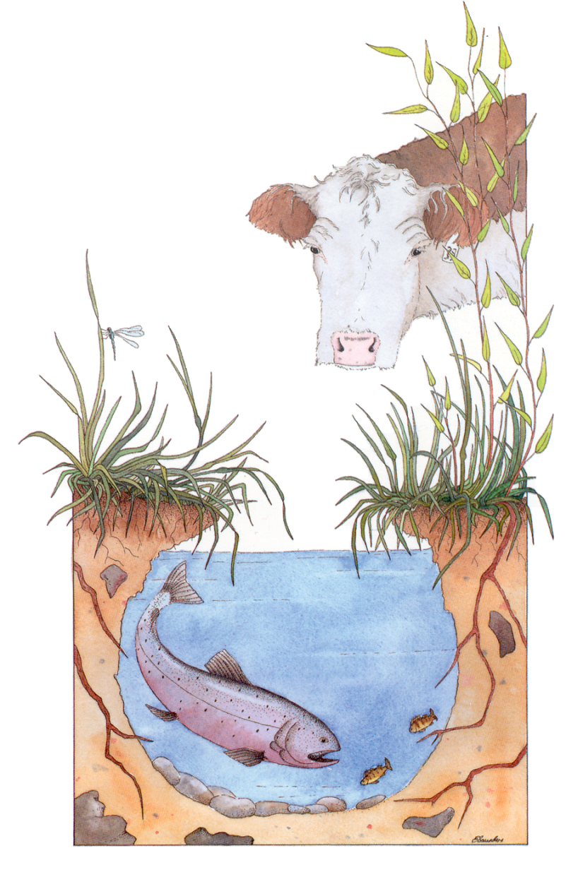
Aquatic Habitat & Bank Stability
Continuous Grazing
Rotational Grazing
Rotation
Residual
Rest
Notes:
What we were finding goes back to the previous observation: by maintaining a rotation that limits the amount of time spent, leaving adequate residual, and then providing a long enough rest period between grazing events, we were able keep healthy deep rooted plants along the stream to protect the streambanks.

Slide 39
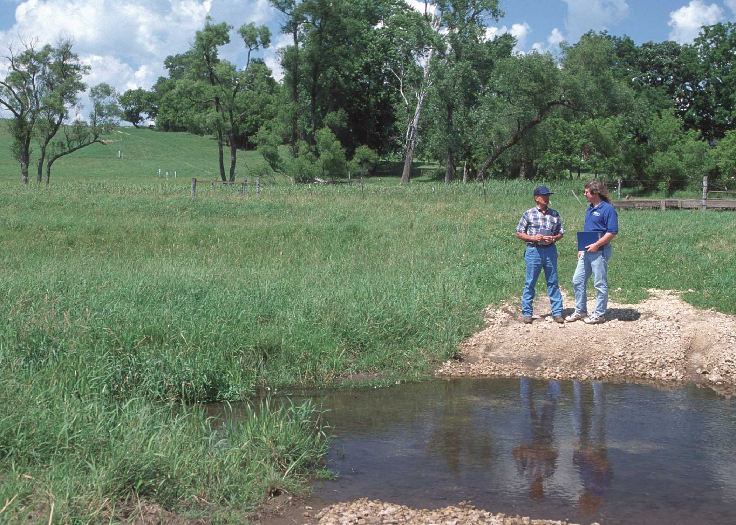
STREAM CROSSINGS
Constructed crossings allow animals safe access to water and protect streambanks
Place where animals like to cross.
Use gravel, geotextile, or cement, depending on conditions.
Use 1.5” rock.
Notes:
We can go further in managing grazing along the streams to reduce the risk of damage. Identifying places where the animals are likely to cross and improving those places reduces the potential for streambank damage elsewhere. One grazier I know uses larger rock in his stream crossing. This makes it a little uncomfortable under foot, so the cattle get their drink and don’t linger in the water.

Slide 40
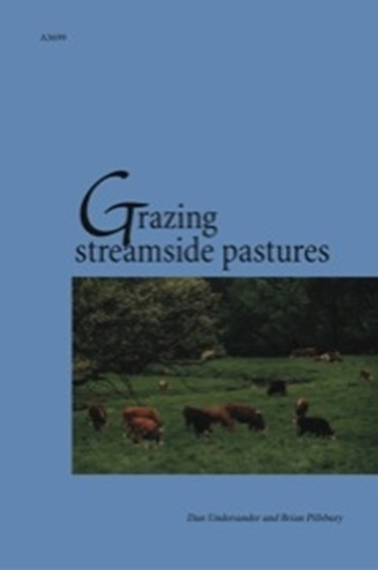
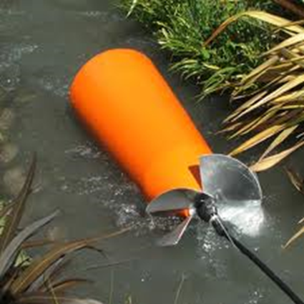
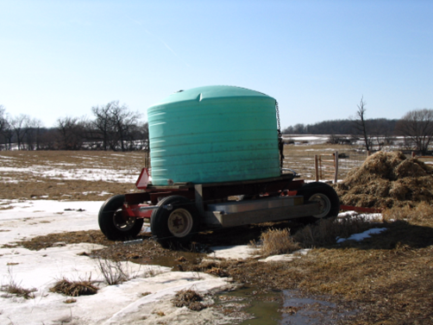
Managing Riparian Pastures
Notes:
Out of that study came a publication that may be of value to you. It is a UW Extension bulleting available from their publishing arm, the Learning Store. In it we summarize what we learned from producers who have been managing along streams. Two fencing approaches are possible. On the left is one that keeps a section of the stream in each paddock. On the right, the stream is separated in its own paddocks so that those paddocks can be skipped if bank conditions aren’t appropriate. The publication also talks about ways of managing water access, including pumping out of the stream into tanks. We find that often livestock, when given a choice, prefer to drink from a tank and one way of reducing bank damage is to offer an alternative source of water.

Slide 41
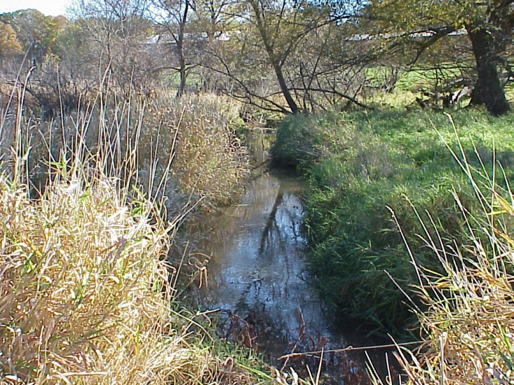
Vegetation management goals: Improve habitat structure? Control invasives?
Grazed sites had more native grasses and sedges and less reed canarygrass, an invasive species in riparian areas and wetlands.
Notes:
There’s also a large and growing body of information on using grazing to manage vegetation. We’ll start with controlling invasives. These are some data from the riparian grazing study I referenced earlier. Although many of us use improved reed canarygrass in pasture mixes, it is an invasive in wetlands and wildlife areas. What we found in our research was that the lowest proportions of reed canary were found in the grazed riparian areas. And as you can see on the right, native grasses and sedges were more prevalent in those areas.

Slide 42
Understanding Animal Grazing Behavior
Species | Grass | Forbs | Browse
Bison | 93 | 5 | 2
Horses | 81 | 5 | 14
Elk | 63 | 16 | 20
Cattle | 64 | 18 | 12
Sheep | 57 | 19 | 20
Goats | 39 | 10 | 50
Deer | 10 | 34 | 57
Notes:
When developing a plan for controlling undesirable vegetation, it’s worthwhile to note that different species have different diets and these differences may lead you to decide to use a particular species or use a multi-species grazing plan to address vegetation issues.

Slide 43
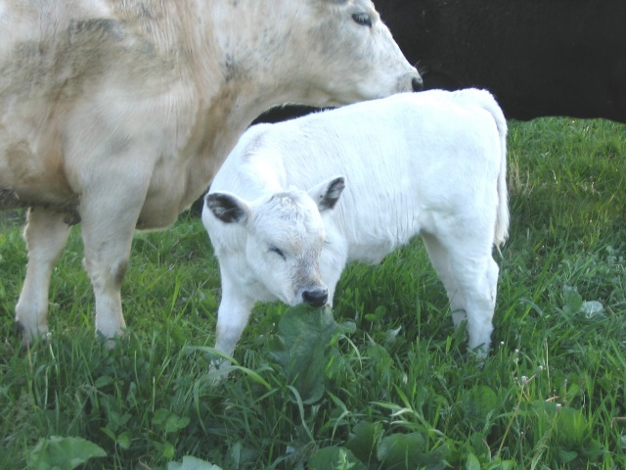
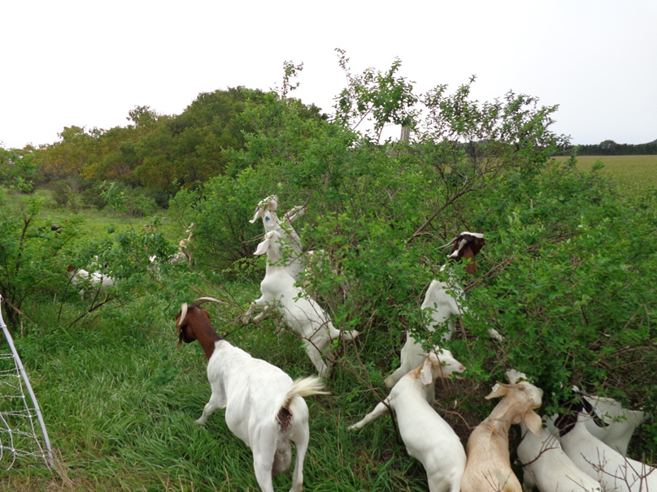
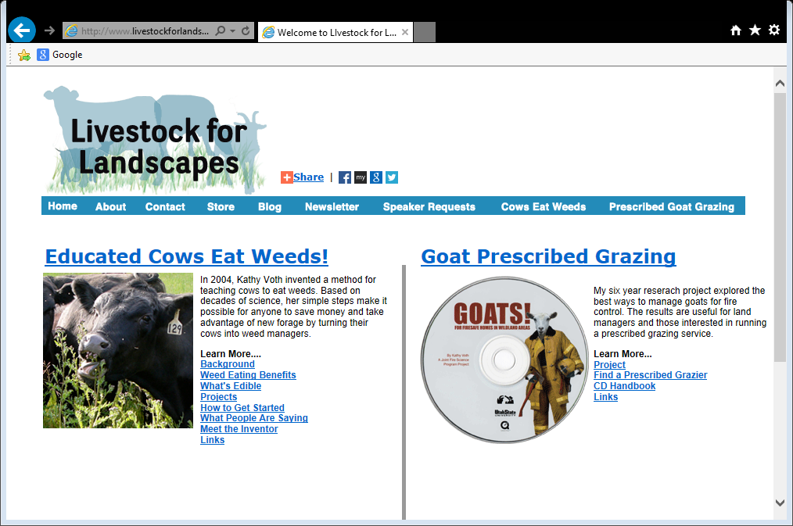
http://www.livestockforlandscapes.com/
Notes:
There is also the potential to train livestock to eat weeds. You may be aware of the growing utilization of goats to reduce weeds and especially brush encroachment. I know of at least three companies in WI alone that ‘rent’ goats for brush control. We can also train other classes of livestock to eat weeds. Kathy Voth, an animal behaviorist from Colorado, has developed a method for training cattle to consume pasture weeds. We used the method to train some of our cows to eat Canada thistles.

Slide 44
Mob Grazing
1,000,000 lbs per Acre
Notes:
Mob grazing is another approach to modifying grassland composition and structure. This is a method that works on a number of weedy species, including thistles. This is one where preparing the landowner for the initial results is important. After the herd moves through, it looks pretty devastated, but the beneficial species come back strong. These species are adapted to this kind of grazing, which simulates what probably happened when herds of bison roamed the prairies.

Slide 45
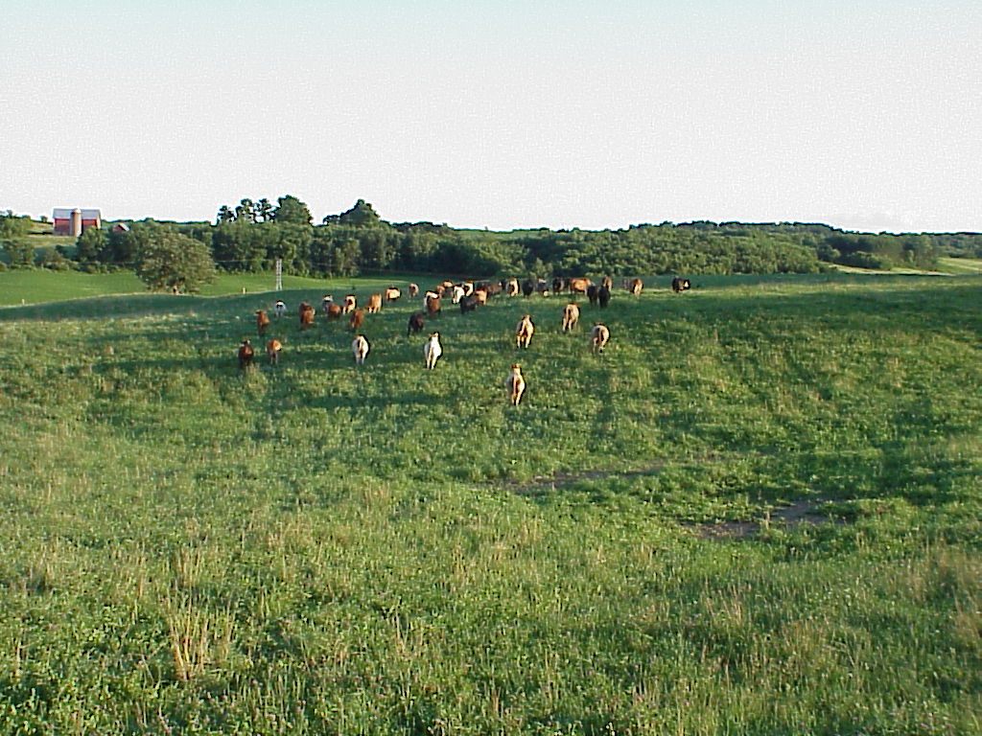
Managing Grazing to Enhance Grassland Bird Habitat
Notes:
Regardless of the species growing in the grassland or pasture, managing it to provide high quality habitat for grassland wildlife is very possible. As noted in the previous slide, the birds of North American grasslands are adapted to grazing. This slide from some Missouri research shows the attraction of grassland birds to the vegetation structure created by grazing. You can see the list of species in the upper right hand corner. Across the x-axis of the graph is vegetation height and what this illustrates is that most of the species select the grazed habitat with shorter more variable structure. There are a few species that prefer tall, dense, idle grasslands as well. The point is that we need to provide habitat across this spectrum in order to have healthy populations of these declining species.

Slide 46
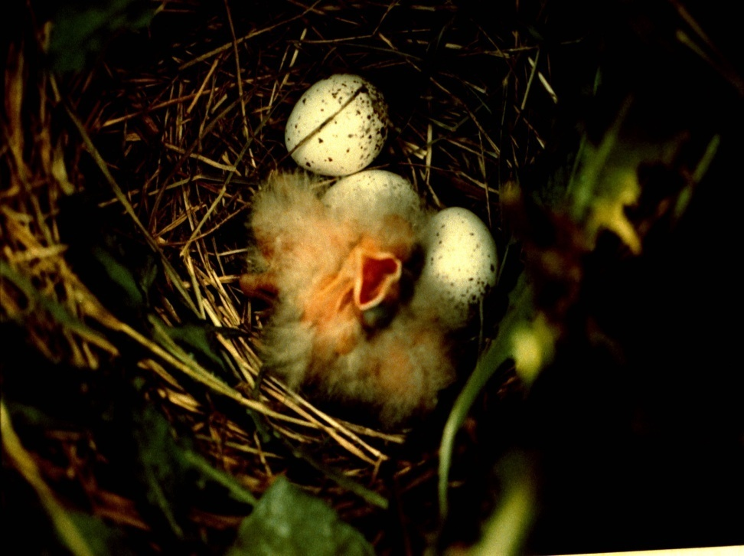
Making Compromises: Nest Survival
Notes:
Grazing does present the need for compromise, however. This graph is a compilation of data from several studies. As you can see, rowcrop fields clearly do not provide habitat attractive to grassland birds (or many other wildlife species for that matter). Alfalfa provides appropriate structure, but nest mortality is high because of poorly timed harvests. Rotational pastures and CRP attracted similar numbers of nesting birds, and as you can see, nest mortality is high even in the relatively ‘safe’ CRP habitat. When we looked at rotationally grazed pasture systems, we found that cattle disturbance reduced nest survival, so we set up some nesting refuges within pasture systems. These idled paddocks performed as well as CRP fields in terms of output of fledglings.

Slide 47
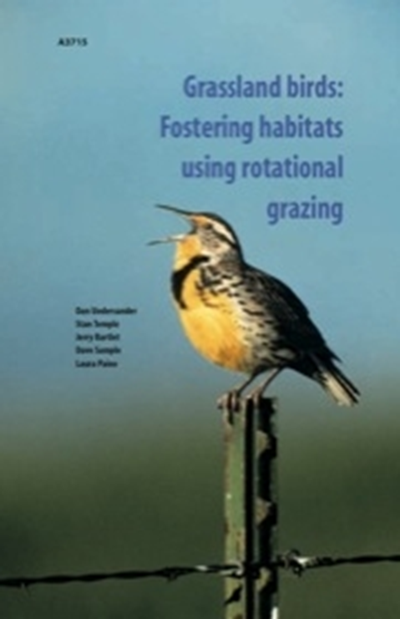
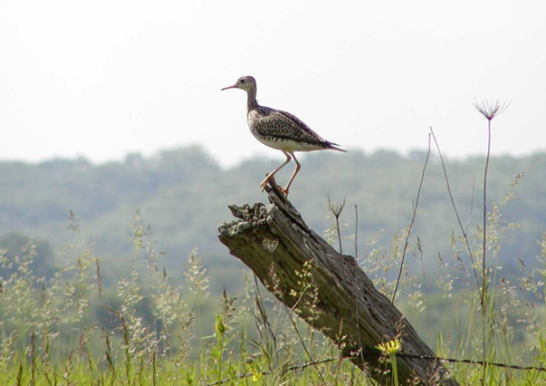
Creating a Nesting Refuge
Woods
Refuge Paddocks
Cool Season Paddocks
Grassland bird nesting season: May and June
Notes:
Here is a model of our ‘bird-friendly’ pasture system, with ¼ to 1/3 of the pasture set aside as a nesting refuge. By setting aside this nesting refuge in the pasture system, there is a place where grassland birds can nest undisturbed. This is also a niche for native warm season pastures. The publication in the upper corner is another Extension bulletin that came out of our research. This idea of a nesting refuge has caught on quite well around the region.

Slide 48
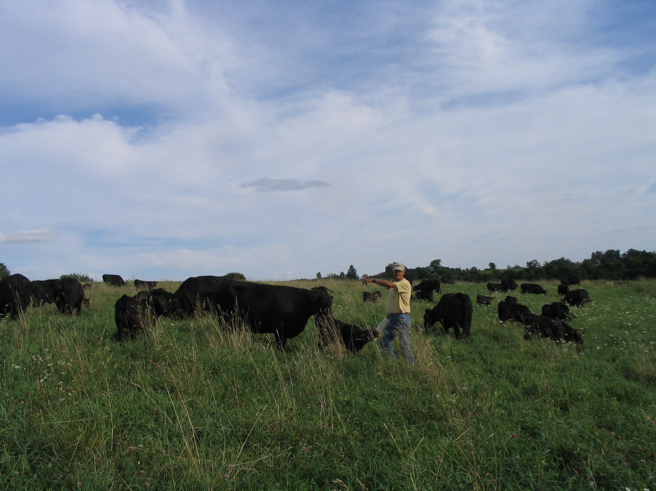
Working Landscapes
Agricultural
Goals:
Incorporating
habitat value
into profitable
agricultural
systems
Conservation
Goals:
Utilizing
livestock
grazing as
a tool for
habitat
restoration
Landowner
Goals:
Income
Aesthetics
Conservation
Avocation
Other?
Notes:
A large majority of the land in the region is owned by non-farming landowners. The Broker project focuses on the notion that non-farming landowners may have a variety of goals. In most cases, they will have economic goals—needing to at least cover the property taxes on the land, or maintain use-value assessment. Beyond that, they may have conservation goals or aesthetic interests that they’d like to meet. Their motivations for owning land may be very different from those of a traditional farmer. But they may not have the opportunity to consider options other than renting to the neighbor who comes and knocks on their door.

Slide 49
Case History
David Anderson Farm
Highland, WI
Notes:
Here is an example of a person who has put this idea into practices.

Slide 50
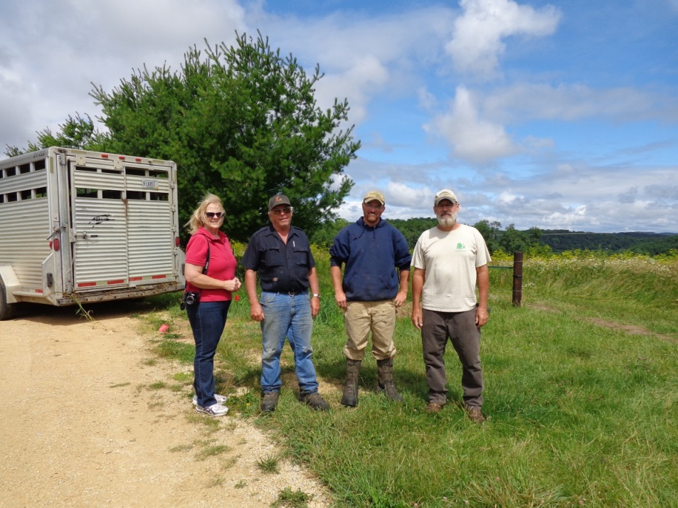
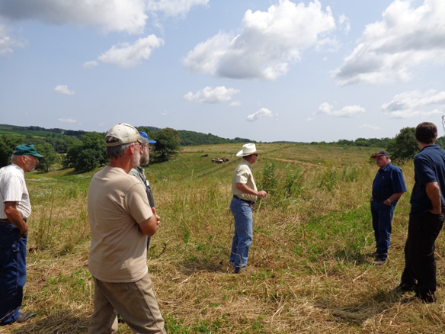
A Grazing-Conservation Partnership

Slide 51
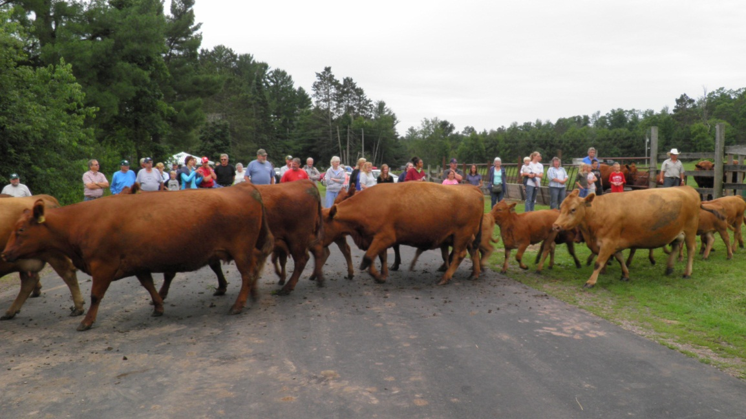
SW Badger’s Grazing Broker Project
An estimated 60% of land in the region is owned by non-farming landowners
www.swbadger.org
Notes:
The idea of the grazing broker is to create a role or position that bridges the gap between the non-farming landowner and the livestock producer. This person provides planning services to identify goals of both parties and incorporate a balance of goals into a grazing plan. The broker also identifies sources of resources for fencing, watering systems, land lease templates, etc.

Slide 52
Simon Lake Challenge Community Based Conservation

Slide 56
Invasive Species Removal
Before
After

Slide 62
By convening farmers, agencies and recreational landowners; in working cooperatively to meet conservation goals, we create a community environment for stewardship and strengthen communities by supporting their efforts.

Slide 63
Questions?
Andy Marcum- andym@landstewardshipproject.org
Phone- 320-424-3901
Laura Paine- lkpaine@gmail.com
Phone- 608-338-9039

Slide 64
Future Webinars

Slide 65
Thank you!

